Slide 1
Types of Communication
Dr. Rajni Pandey
Assistant Professor
MMC, Patna University, Patna.

Slide 2

“COMMUNICATION IS THE PROCESS BY WHICH TWO OR MORE PEOPLE EXCHANGE IDEAS, FACTS, FEELINGS OR IMPRESSIONS IN WAYS THAT EACH GAINS A COMMON UNDERSTANDING OF THE MEANING, INTENT AND USE OF MESSAGES.”
-LEAGANS

Slide 3
Communication takes many forms according to the style of expression, the occasion and situation, the symbols and the medium used as per the relationship between the persons involved and such other factors.

Slide 4
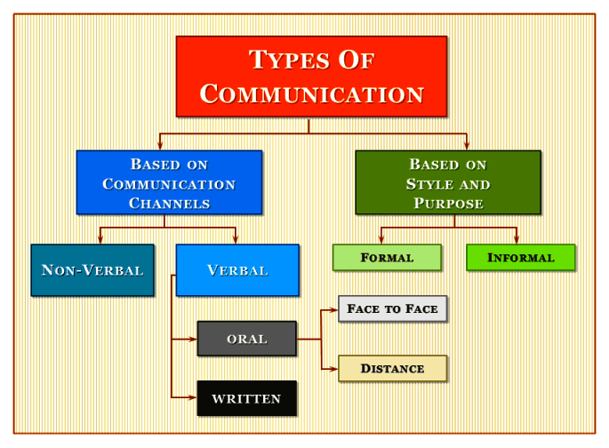

Slide 5
One way vs Two way communication
One way communication is characterized by absence of feedback from the receiver whereas Two way communication involves active feed-back from the receiver to the sender to ensure that the receiver has understood the message in the same sense that sender intends to convey.

Slide 6
VERBAL COMMUNICATION
Verbal communication involves the use of symbols that generally have universal meanings for all who are taking part in the process. Types of verbal communication are:
Oral Communication
Written Communication
Oral communication is that channel of communication in which message is transmitted in spoken form.
Written Communication is that in which information is exchanged in the written or printed form.

Slide 7
NON-VERBAL COMMUNICATION
Non –verbal communication means transmission of meaning other than oral or written words. This transmission can be through facial expression, body posture, eye contact etc.
Types of non-verbal communication are
KINESICS: it is the study of body movements to judge inner state of emotions expressed through different parts of the body.
FACIAL EXPRESSIONS
GESTURES
POSTURES
PROXEMICS
PARALANGUAGE It involves the study of voice quality, volume, speed rate and the manner of speaking beyond the words. E.g. shaky voice reveals nervousness, clear voice reveals confidence, broken voice reveals lack of preparation etc.

Slide 8
FORMAL COMMUNICATION
Formal communication is communication structured on the basis of hierarchy, authority & accountability.
Types of Formal Communication
Upward Communication: Sending of message from subordinates to superior.
Downward Communication It is the flow of information from superior to subordinate in the organisational hierarchy.
Horizontal Communication It refers to the horizontal flow of message among colleagues.

Slide 9
INFORMAL COMMUNICATION
Informal communication is relatively less structured & spontaneous communication arising out of day to day routine & meetings among people.

Slide 10
INTER-PERSONAL COMMUNICATION
Interpersonal communication is communication among two or more persons. It is an important element of the organisation.
INTRAPERSONAL COMMUNICATION
It is internal dialogue occurring within the mind of an individual. It may be clear or confused depending upon the individual’s state of mind.

Slide 11
GROUP COMMUNICATION
It takes place in meeting helps in understanding a situation, exploring possibilities and in solving problems because it allows a multiple point of view. It gives the participants an over-view of the organization and the issues discussed and enable them to appreciate other people’s point of view. Multiple barriers operate in group communication. The participants have to be committed to group decisions and activity. The size of the group affects its communication. The minimum number is three and the maximum for effective communication is ten, though larger groups of up to fifteen can manage to have effective communication

Slide 12
MASS COMMUNICATION
Mass communication is a public communication. It is a one way communication which includes messages disseminated by radio, television, the press and through the internet. It is used for circulating information and instruction to the people, for disseminating information about themselves, for advertising, and for propaganda. It has single source and multiple receivers, the content is open to all, audiences are heterogeneous and it can establish simultaneous contact with every large numbers of people at a distance from the source and widely separated from one another.

Slide 13

THANK YOU!!!

