Slide 1
Old English
&
Middle English
- Dr. Archana Jaiswal
Associate Professor
Department of English
Magadh Mahila College

Slide 2
Content
Old English Period
Old English Dialects
Grammatical Changes in Old English Period.
Middle English Period
Middle English Dialects
Grammatical Changes in Middle English Period

Slide 3
Old English

Slide 4
Old English Period
The period extend from 450 AD to 1066 AD.
Also called as Anglo-Saxon
The Angles, the Saxons and the Jutes, had started filtering in England during the 5th Century.
These tribes set up seven kingdoms called the Anglo- Saxon heptarchy.
Anglo- Saxon gave Britain a new name England– the Land of angles, and a new language, English the language of angles.

Slide 5
Old English Dialects
Northumbrian in the North comprising the district between the Firth or Forth and the Humber river .
Mercian, spoken between the Humber and the Thames.
West Saxon, spoken in the region south of the Thames except in Kent and Surry.
Kentish spoken in Kent and Surry.

Slide 6
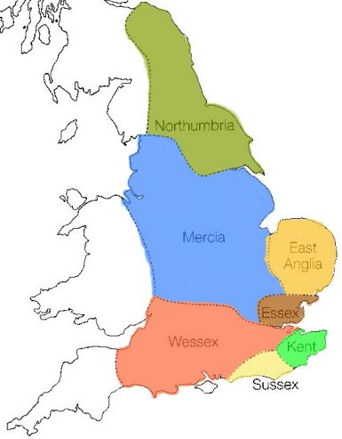

Slide 7
Old English Grammar
Old English had a very complicated grammatical system, with a number of different declensions of the noun.
This period has often been described as the period of “full inflections”.
Being highly inflected, Old English had a relatively free word order.
In Old English we find four cases, Nominative, Accusative, Genitive, and the Dative case.
In Old English there were two separate declensions of adjectives, the weak and the strong.
In Old English, verbs had only two tense, the present and the preterit (like the past).

Slide 8
Old English Pronunciation
Old English was more or less phonetic in character , its spelling representing its pronunciation fairly closely.
The two major sound change on Old English were- mutation and gradation.

Slide 9
Old English Spelling
The old English spelling was phonetic in character, each letter representing a sound and it contained no silent letters.
Old English has seven vowels a,e,i,o,u,y (a+e) was the specialty of Old English.
Old English remained a phonetic language without the discrepancy between spelling and pronunciation.

Slide 10
Old English Vocabulary
This period is remarkable for its high degree of purity, with only a small amount of Latin loan words.
The Old English word stock was enriched by Indo-European words, Celtic element, Latin influence and the Scandinavian influence.

Slide 11
Latin Vocabulary in Old English
Latin words entered Old English in two phases:
(1) during the Roman occupation.
(2) through the early Christian missionaries

Slide 12
Middle English Period

Slide 13
Middle English
Middle English started with the Norman Conquest .
A period of great change.
English becomes official language of the law courts. More and more authors are writing in English.
Decay of Inflectional Endings.
French Influence on the Vocabulary of Middle English.

Slide 14
Period Of Change
The causes of changes:
(i) Norman Conquest
(ii) Loss of a large part of Old English words.
(iii) Add thousands of words from French and Latin.

Slide 15
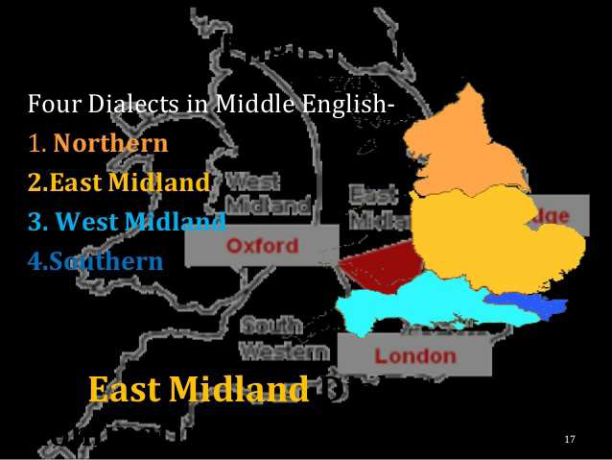
Dialects

Slide 16
Middle English Dialects
Principal dialects of Middle English.
i) Northern: - The Northern dialect extends as far south as the Humber.
ii) East Midland & West Midland:-They together cover the area between the Humber and the Thames.
iii) Southern :- Southern occupies the district south of the Thames.

Slide 17
French Influence on Vocabulary
Normans brought French in England. Thousands of French words added in English Vocabulary.
French influence is much more direct and observable upon the vocabulary. French and English Peoples lived side by side a long time.
French words poured into English with a momentum that continued until toward the end of the Middle English period.

Slide 18
Decay Of Inflection Endings
There was a general reduction of inflectional endings of the noun.
Case and Gender were altered in pronunciation.
The loss of inflection also appeared in verbs.
The vowels (a,o,u,e) in inflectional endings were transferred to a sound called indeterminate vowel.

Slide 19
Middle English Grammar
The Noun
In early Middle English only two methods of indicating the plural remained the –s or –es.
The Pronoun
i) The reduction of inflection was apparent in the demonstratives
ii) The and that surviving through Middle English and use today.

Slide 20
The Verb
i) Nearly a third of the old English strong verbs died out early in the Middle English.
ii) Today more than half of the Old English strong verbs have disappeared completely from the standard Language.
The use of “he” for Male and “she” for Female started in Middle English Period.

Slide 21
Thank You

