Slide 1
Waste Management in India
ITP & ES DIVISION
MINISTRY OF EXTERNAL AFFAIRS
JUNE 2016

Slide 2
INDIA: SOLID WASTE STATISTICS
Annual Waste - 62 million tonnes
Plastic Waste - 5.6 million tonnes
Biomedical Waste - 0.17 million tonnes
Hazardous waste - 7.90 million tonnes
E-waste - 1.5 million tonnes
Per capita waste generation in Indian cities ranges from 200 grams to 600 grams per day.
43 million TPA is collected,
11.9 million is treated and
31 million is dumped in landfill sites,
Only about 75-80% of the municipal waste gets collected and only 22-28 % of this waste is processed and treated.
Waste generation will increase from 62 million tonnes to about165 million tonnes in 2030”
It is projected that by the year 2031 the MSW generation shall increase to 165 million tonnes and to 436 million tons by 2050.
If cities continue to dump the waste at present rate without treatment, it will need 1240 hectares of land per year and with projected generation of 165 million tons of waste by 2031, the requirement of setting up of land fil for 20 years of 10 meters height will require 66,000 hectares of land.
Untapped waste can:
Generate 439 MW of power from 32,890 TPD of combustible wastes including Refused Derived Fuel (RDF),
1.3 million cubic metre of biogas per day, or 72 MW of electricity from biogas; and
5.4 million metric tonnes of compost annually to support agriculture.

Slide 3
India: Solid Waste Management (SWM) Rules after 16 years…New rules announced on 5th April 2016
These rules are the sixth category of waste management rules brought out by the Ministry of Environment, Forests & Climate Change. The Ministry had previously notified plastic, e-waste, biomedical, hazardous and construction and demolition waste management rules
Rules applicable beyond municipal areas and will extend to urban agglomerations.
Waste processing facilities will have to be set up by all local bodies having 1 million or more population within two years.
For census towns below 1 million population, or local bodies having 0.5 million or more population, or census towns under 0.5 million population standalone sanitary landfills will have to be completed in three years.
Central Monitoring Committee for Solid Waste Management constituted under the chairmanship of Secretary, Ministry of Environment, Forest and Climate Change to monitor the overall implementation of the Rules.
The Committee comprises:
Ministry of Urban Development,
Ministry of Rural Development,
Ministry of Chemicals and Fertilizers,
Ministry of Agriculture, Central Pollution Control Board,
3 State Pollution Control Boards /Pollution Control Committees,
Urban Development Departments of 3 State Governments,
Rural development departments from two State Governments, three urban local bodies, two census towns,
Federation of Indian Chambers of Commerce & Industry (FICCI)
Confederation of Indian Industry (CII) and
Two subject experts
The Committee will meet once an year to monitor the implementation of these Rules.

Slide 4
Some of the salient features of SWM Rules, 2016
Hotels and restaurants should segregate biodegradable waste and set up a system of collection to ensure that such food waste is utilized for composting / biomethanation.
Resident Welfare associations and gated communities with an area >5,000 sqm should segregate waste and handover recyclable material to either the authorized waste pickers or the authorized recyclers, or to the urban local body.
Bio-degradable waste should be processed, treated and disposed of through composting or bio-methanation within the premises as far as possible.
Street vendors should keep suitable containers for storage of waste generated and deposit such waste at waste storage depot or container or vehicle as notified by the local authority.
High calorific wastes shall be used for co-processing in cement or thermal power plants.
Developers of Special Economic Zone, industrial estate, industrial park to earmark at least 5% of the total area of the plot or minimum 5 plots/ sheds for recovery and recycling facility.
Manufacturers of disposable products such as tin, glass, plastics packaging etc. shall provide necessary financial assistance to local authorities for the establishment of waste management system.
Companies that sell products in non-biodegradable packaging material should put in place a system to collect back the packaging waste generated due to their production.
All such manufacturers, brand owners or marketing companies should educate the masses for wrapping and disposal of their products.
Construction and demolition waste should be stored, separately disposed off.

Slide 5
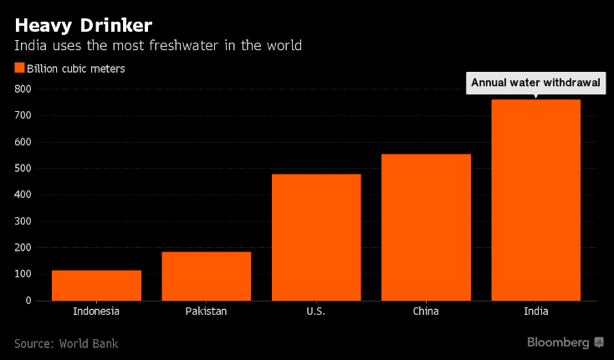
STRESS OF WATER IN INDIA
In 2014-15, India exported 37.2 lakh tonnes of basmati. To export this rice, the country used around 10 trillion liters of water.
In other words, India virtually exported 10 trillion liters of water.
At least one-fifth of this would have been surface/groundwater.
In these times of global climate change, water is the one commodity where you do not want a trade surplus.
India’s annual freshwater withdrawal exceeds that of even China

Slide 6
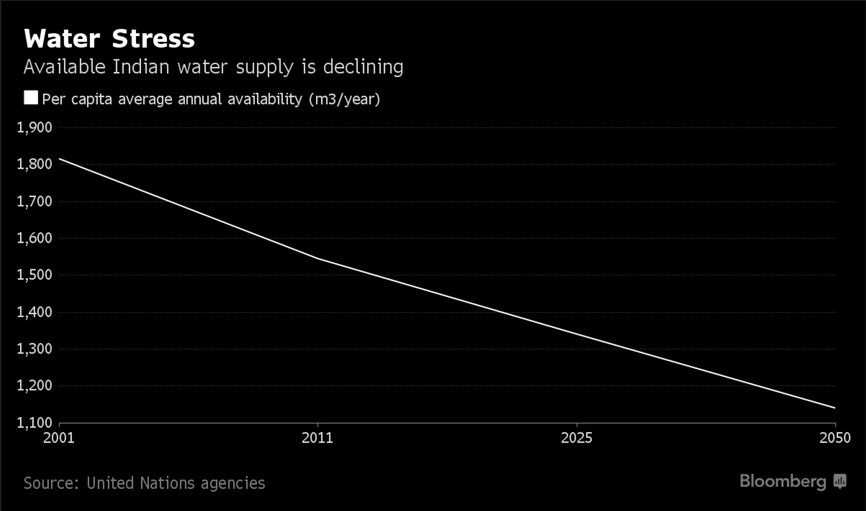
India’s largest cities produce 38 billion liters of waste water daily, all of which will have to be recycled eventually.
While that requires major investment in treatment facilities, the government will need to provide sufficiently attractive waste water contracts to realize the full potential of the market.
When per capita availability drops below 1,700 cubic meters annually, the situation is described as water stressed. By 2050, India won’t be far from the 1,000 cubic meter mark below which water scarcity begins.

Slide 7
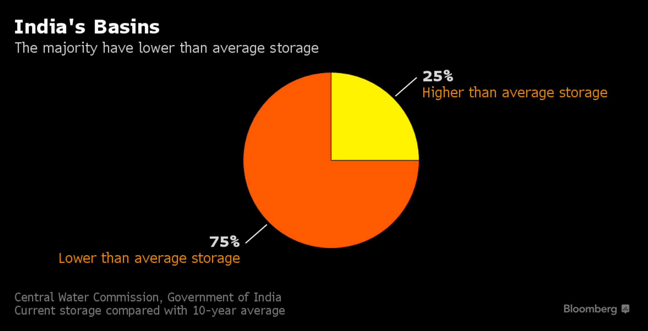

Slide 8
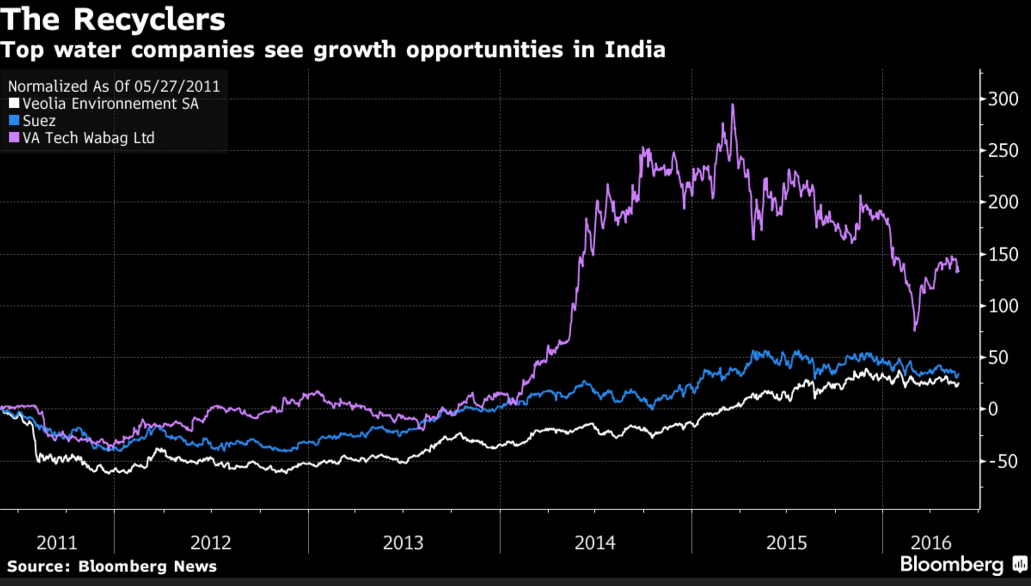
India’s water crisis is set to spur the development of a market for recycling plants that could eventually be worth at least $17 billion.
Both Veolia Environnement SA and Suez Environnement Co., two top European water companies, said last year that they are looking to expand in India.
Chennai-based VA Tech Wabag Ltd., which builds treatment plants, has climbed 130 percent in the past five years.

Slide 9
URBAN SEWAGE IN INDIA
While 87% of the country’s urban population has access to household or community sanitation, the collection, treatment and disposal of wastewater is a cause for concern.
Only one-third of all households are covered by sewer networks, with 47% of households relying on on-site sanitation systems. The low coverage is also compounded by the grossly insufficient treatment capacities in urban centers.
According to the Central Pollution Control Board’s (CPCB) Inventorization Of Sewage Treatment Plants Report of (2014-15), 816 municipal sewage treatment plants (STPs) listed across India, 522 work.
Of the 62,000 MLD, the listed capacity is 23,277 MLD but no more than 18,883 MLD of sewage is actually treated. Meaning 70% of sewage generated in urban India is not treated.
While 79 STPs do not work, 145 are under construction and 70 are new projects proposed for construction.
Of the 522 working STPs across India, maximum are in the northern state of Punjab, which has 86. But no more than 38 work.
Uttar Pradesh has the most working STPs, 62, followed by Maharashtra (60) and Karnataka (44). About 17 million urban households lack adequate sanitation facilities in India, with 14.7 million households having no toilets,

Slide 10
URBAN SEWAGE IN INDIA…2
In India, different treatment technologies like ASP, UASB, Oxidation pond and advanced technologies like SBR, MBR are adopted for the treatment of sewage.
Operation and maintenance of existing treatment capacity is below par, with 39% plants not conforming to environmental rules for discharge into streams, the CPCB’s 2009 report said.
An estimated 75% to 80% of water pollution is from domestic sewage, discharged untreated into local water bodies.
The government plans to construct 2.5 million individual household toilets in urban areas by 2015-16, of which 882,905 were constructed up to December, 2015,
The Integrated Ganga Conservation Programme (Namami Gange) has been approved by the Cabinet, with an outlay of Rs 200 billion for the next five years.
So far, 93 projects worth Rs 74 billion have been approved for creating a treatment capacity of 858 mld and a sewer network of 3,623 km.
Programmes like the Swachh Bharat Mission, 100 Smart Cities and the Atal Mission for Rejuvenation and Urban Transformation (AMRUT) aim to further expand the sewerage network and treatment capacity.
To augmen the financial resources of urban local bodies (ULBs), the government has increased the provision for the Pooled Municipal Debt Obligation facility from Rs 50 billion to Rs 500 billion. This is in addition to extending the facility for five years ending March 2019.
The hybrid-annuity based public-private partnership (PPP) model is also being explored to revive investor interest in the sector. Decentralized STPs have been commissioned; recycling & reuse has gained more acceptance; energy generation from sewage is receiving greater focus; and advanced membrane-based technologies are being deployed.

Slide 11
APPLICATION OF TECHNOLOGIES
Technologies is use: Range from pond-based systems to Activated Sludge Process (ASP) and its variants to advanced or tertiary treatment technologies such as Membrane Bio-Reactor (MBR), reverse osmosis systems, carbon adsorption etc.
Secondary treatment technologies: Pond-based systems are generally used for smaller capacities of 20 mld or less, while for larger capacity treatment plants the preference is for ASP or its variants and equivalent systems such as Upflow Anaerobic Sludge Blanket (UASB), Fluidized Aerated Bed (FAB), Moving Bed Bio-Reactor (MBBR) and Sequential Bed Reactor (SBR).
For very large plants of capacity greater than 50 mld, the preference is to use either SBR or ASP with methane power generation facility.
Companies are also employing zero liquid discharge (ZLD) system – an advanced technology to purify and recycle virtually all of the wastewater produced.
Another area of increasing focus is real-time monitoring and automation. This is expected to play an important role in the years to come, considering that even more stringent regulations are likely to be put in place by the end of this decade.
Cutting edge trends include increased water recycling and reuse programs to reduce water consumption and discharge needs, implementation of solid waste (sludge) reduction and waste-to-energy projects, use of advanced treatment technologies and a focus on reducing energy costs associated with wastewater treatment.
In some cases, manufacturers are combining to create common effluent treatment plants(CETPs) to improve wastewater treatment economics. CEPTs cost less to build and operate on a per-cubic-meter-treated basis than a collection of individual sites.

Slide 12
APPLICATION OF TECHNOLOGIES…2
The cost of a wastewater treatment plant depends on two key factors - the quality of raw influent and the quality of the receiving medium.
Most cities in India do not have facilities to treat human excreta or chemical industrial waste. Furthermore, these plants are technologically backward and were built at times when the nature of waste was biological and not chemical. With time, the quantity and characteristic of wastewater discharge has drastically changed. In their current state, most wastewater treatment plants are obsolete and are in need of newer technology and capacity expansion.
An important factor that hinders wastewater treatment is unavailability of land for building new plants. Land is in short supply in urban India and also a very expensive commodity. As a result, cities and towns are finding it difficult to manage and treat the huge quantities of waste generated on a daily basis.
Construction and maintenance costs are major deterrents too. According to the government report, in the mid-1990s, when the first-generation sewage treatment plants were built, they cost Rs 20 lakh to Rs 30 lakh per MLD (million litres per day).
Today, the same plants cost close to Rs 1 crore per MLD to build. India's deficit of sewage treatment would require huge investment, if only greenfield options are considered.
'Retrofit' or up-gradation of existing wastewater treatment plants can solve problems of increased capacity as well as need for improved quality. Retrofitting can be defined as addition of new technology or features to older systems.
Retrofitting is less capital-intensive than building a new plant, optimizes the working of the existing plant while also increasing its lifespan. Membrane technology plays a vital role in retrofits. Low-pressure ultrafiltration membranes that can be fitted downstream of aeration systems of existing plants offer multiple benefits of capacity expansion and improved effluent quality.

Slide 13
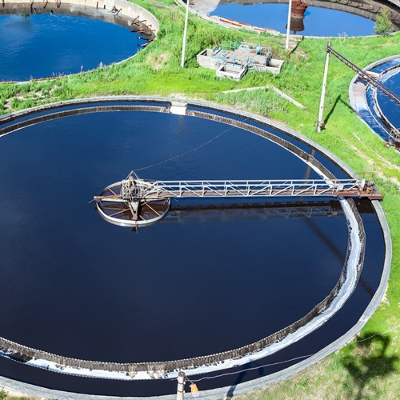
Few advantages of retrofitting with membrane technology include: • Improved productivity of wastewater treatment plants • Reduction in per unit operating costs • Significant improvement in quality that can make effluent reusable in non-potable applications.
Treatment plants that used to discharge effluent could be upgraded and treated effluent could serve as a revenue generator.
Examples of retrofits in India can be seen in the industrial sector, where plants have seen increase in capacity by > 80% and improvement in effluent standards to reuse levels. This has been achieved with minimal investment in land and civil works. Such practices need to be translated in the Municipal segment as well, thus reducing the investment burden for new plants.

Slide 14
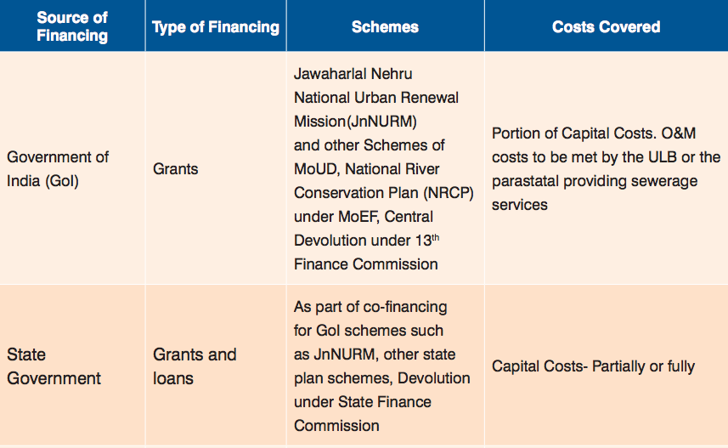
Financing for Sewerage Projects in India

Slide 15
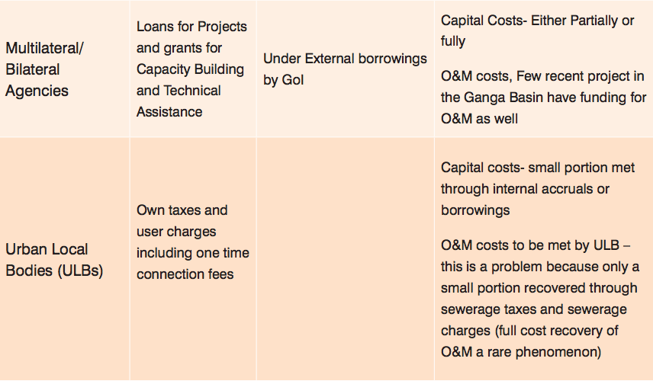
Financing for Sewerage Projects in India

Slide 16
BUSINESS MODELS FOR PRIVATE SECTOR PARTICIPATION IN SEWERAGE SECTOR
Design, Build, Operate Model (DBO):
In this model, ULB or parastatal meets the capital costs for the project, and uses the private sector to bring in technology and managerial skills to operate and maintain the assets.
In most contracts, an EPC contract is awarded to the selected operator for construction of the sewerage assets linked to milestones and a separate fee is paid for operations and maintenance of the asset.
Early contracts in this sector had O&M contracts for a period of 5 years, though some recent contracts have extended the tenure to upto 10 years.
In this model, the construction, technology and operating risks are borne by the private sector operator while the financing risk is borne by the government counterpart.
Build, Operate, and Transfer Models (BOT): These models are primarily concessions, where the private sector designs, constructs, finances capital expenditure, operates and maintains the assets and at the end of concession period returns it to the Concession Granting Authority (CGA). In practice there are three variants of the BOT model followed in India:
BOT Third Party PPP(Annuity) – in this case, a third party operator is hired by the CGA to provide wastewater collection, treatment and discharge/ reuse services to the end users and is paid an annuity by the CGA to cover capital and O&M costs.
BOT Third Party PPP (User Charge) – in this case, a third party operator is hired by the CGA to provide wastewater collection, treatment and discharge/ reuse services to the end users and collects user charges in return from end-users itself to recover its capital investments, cover O&M costs and meet its return expectations. These Models are also known as Design, Build, Finance, Operate, Transfer (DBFOT).

Slide 17
BUSINESS MODELS FOR PRIVATE SECTOR PARTICIPATION IN SEWERAGE SECTOR
BOT End User PPP – in this case the end user is an industrial firm or power plant which is a bulk consumer of water.
The end user or consumer itself is the private operator, hence owns and takes responsibility for the project. The end user purchases either treated or raw sewage from the ULB / Water Utility from its STPs/discharge points through a long term wastewater supply or purchase contract; conveys it to its facility; and treats it to a level required by it for its internal process and other non-potable uses.
The end user is responsible for financing all the capital and operating expenditures required for the conveyance infrastructure and additional treatment facilities. In certain cases, the end user undertakes to operate the municipal STPs for the ULB / Water Utility at its own cost as well, in return for free treated sewage supplies from the STPs through a long term agreement.
The benefit is the cost savings emanating from a stable source of water of the requisite quality for own use at a cost which is lower than the cost of alternative sources of treated water.

Slide 18
WHICH BUSINESS MODEL WILL WORK IN INDIA
For DBOs to be successful it is essential to:
scope the project well, provide extensive and up to date technical and financial information to the bidders;
have a clear bid selection parameter;
provide O&M/Management Fee guarantees to the operator.
Another essential factor is the public sector’s source of funding capital expenditures. Financing in the form of grants and term loans by Government of India and multi-lateral and bi-lateral donor agencies assures timely and full payment of capital expenditure dues of the private contractor as per the payment schedule.
BOT End-User PPP – They are successful because there is:
Strong ownership of the project by the end-user as well as the ULB (which earns royalty revenue on recycled sewage and sometimes savings in O&M expenditure on its secondary treatment STPs); and
The project is driven by end-user needs underpinned by economic factors such as cost of procuring water from alternative sources as determined by the end-user itself. The consequent high level of commitment as well as an intimate understanding of user requirements ensures that the project is designed according to the specifications of the end-user and is able to withstand the delays and increases in cost caused by, among others, land acquisition problems, change in scope due to inadequate project preparation and contract limitations.

Slide 19
BOT Third-Party PPP (Annuity) – The success factors associated with this category of PPP are:
Presence of detailed studies to assess need, scope the project and collect up to date technical and financial information for bid purposes;
Majority (70% to 90%) of the project cost is funded by grants from Centre and States as well as low-cost, long tenor loans from multi-lateral and bilateral agencies ensuring low fixed capital investment costs for the private operator hence low annuity payment requirements;
Contractual assurances regarding full and timely annuity payments by the ULB and/or the State Government.
In case of operator non-performance due to inadequate quantity or poor quality of sewage supplied by the ULB, contractual assurance by ULB and/or State Government to the operator of payment of its annuity without penalty; and
Strong political will or commitment shown by the ULB and the State Government to champion and steer the project through difficulties as well as facilitate permits and land acquisition.
BOT Third-Party PPP (User Charge) – The main success factors for this category of PPPs are:
Authenticity of detailed, up to date and reliable data on sewerage system, quantity and quality;
Extensive stakeholder consultations including their end-users to:
determine need, define scope including STP sites and network alignment,
arrive at a mutually acceptable tariff;
generate public support for the project, which in turn reduces socio-political risk considerably;
3. Enshrine the right of the private operator to:
request from end-users minimum off take or a fixed cost coverage guarantee,
disconnect reuse water supply in case of non-payment of dues and/or request security deposits/financial guarantees equivalent to X months’ revenues.
4. Political will, which is essential to facilitate the permitting and land availability process as well as to ensure government support in steering the project around unforeseen hurdles in implementation and operation

Slide 20
WASTE TO ENERGY
Ongoing Waste-to-Energy (WTE) projects as of March 2016:
24 waste-to-energy projects to produce 233MW are currently in different stages of construction and
5 projects of 79MW have already been tendered, adding up to a total of 312 MW.
Once all this capacity comes on stream, India’s WTE capacity will go up by six-fold from the current 53MW produced from five such projects.
As per estimates by the Urban Development ministry, about Rs.65,000 crore of public and private investments will flow into city waste management, cleanliness and waste-to energy projects over the next three years.
GOIs revised tariff policy mandates power distributors to buy all the electricity from WTE plants in a State and the remunerative tariff set for it by the Central Electricity Regulatory Commission (CERC) has helped raise investor interest in this segment.
CERC in Oct 2015 fixed a tariff of Rs.7.9 per kilowatt hour of electricity sold by waste-to-energy plants, compared to about Rs.2.5 applicable for many thermal power plants.
Target: 10 gigawatt (GW) of electricity generation capacity out of the 175GW renewable energy that India wants to have by 2022, is to come from bio-power.
New waste-to-energy capacity is coming up in places like Nalgonda district and Hyderabad in Telangana, Bawana and Kidwai Nagar in Delhi, Jabalpur and Indore in Madhya Pradesh, Pune and Kolhapur in Maharashtra, Pallavaram in Chennai, Allahabad and Agra in Uttar Pradesh and Bathinda and Jalandhar in Punjab.
Hyderabad, Pune, Indore and Rajkot have floated tenders for new projects which are to be completed early in 2018.

Slide 21
Thank You

