Slide 1
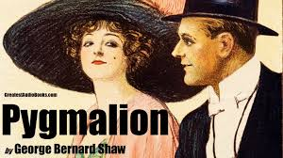
Myth, Class and Feminity: A Critical study of Shaw’s “Pygmalion”
Reading of Pygmalion
-Dr. Archana Jaiswal
Associate Professor
Magadh Mahila College

Slide 2
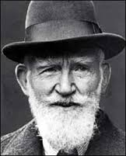
“ I must warn my readers that my attacks are directed against themselves, not against my stage figures.”
- Shaw

Slide 3
George Bernard Shaw
Shaw was born in Dublin, Ireland in 1856.
He lacked any professional training due to his dislike of it.
In 1876 he moved to London and became a music and theatre critic and a member of the Fabian Society.
Shaw used his plays to expose the hypocrisy and complacency of British Society.

Slide 4
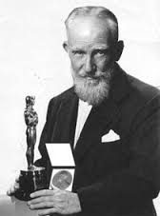
George Bernard Shaw
Shaw was awarded the
Nobel Prize for literature
in 1925.
He is much more the
propagandist than the
artist because he paints
in loud colors.
He continued to write
until he was 94.

Slide 5
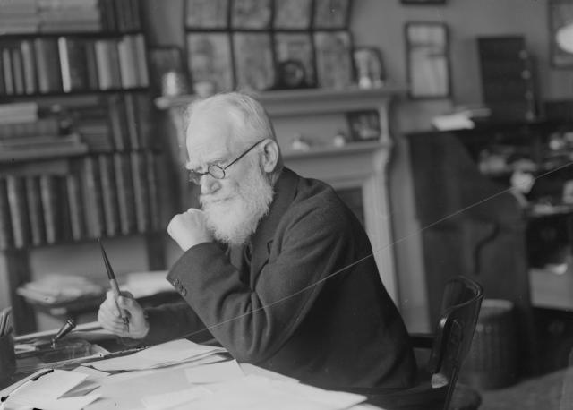
“For art’s sake alone I would not face the toil of writing a single sentence.”
-Shaw

Slide 6

Setting of the play
London, 1912
During this era, both in
the play and in real life,
there were huge differences between the rich
and the poor.
Social classes were clearly defined, and it was
hard to move from one class to another.
Women did not have the same rights as men
and were often looked to as inferior.

Slide 7
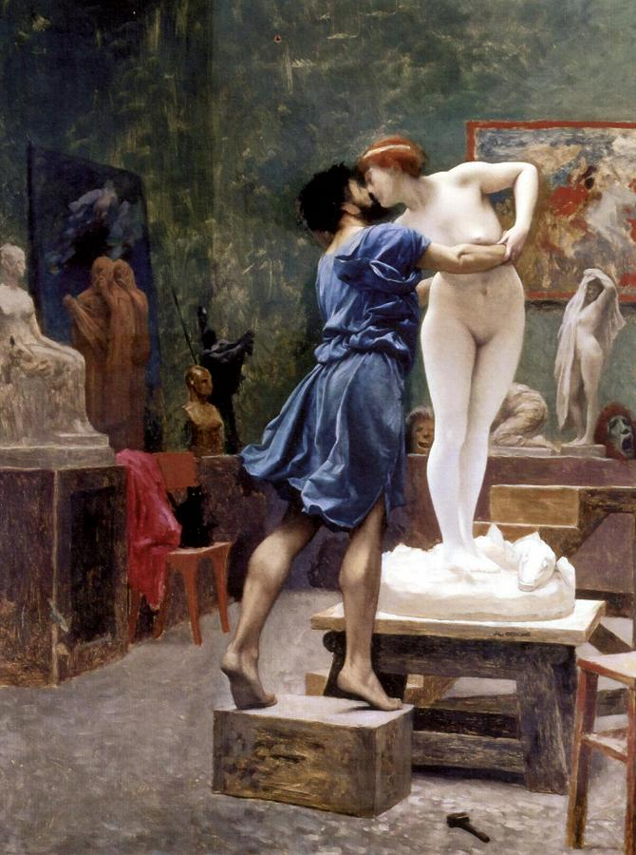
Myth of Creation
The tale of “Pygmalion” as
written by Ovid is of a
gifted young sculptor,
Pygmalion who falls in love
with his own creation,
Galatea and wishes to give
his creation life.

Slide 8
Professor Higgins is also like Pygmalion in his view of woman – cynical and derogatory;
Higgins says, “ I find that the moment I let a woman make friends with me, she becomes, exacting, suspicious, and a damned nuisance.”
Shaw’s “Galatea”, Eliza, develops a soul of her own and a fierce independence from her creator.

Slide 9
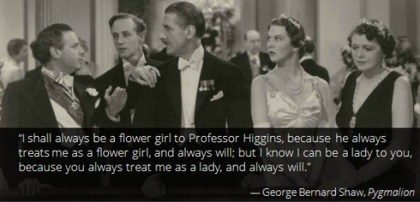
Class and Society
In Pygmalion,
we observe a
society divided,
separated by
language,
education and
wealth.

Slide 10
Shaw satirizes the British concept of social graces and class as being the measure of a person’s worth.
If you are treated as a member of upper classes, you’ll be accepted by them and vice versa.
“Eliza:- The difference between a lady
and a flower girl is not how she
behaves, but how she’s treated.”

Slide 11
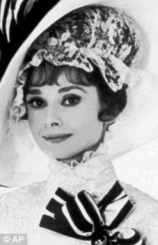
The Feminist Perspective
Feminism is a very
prominent theory
throughout the novel.
Shaw portrays a society
in translation, in which
progressive notions of
feminity clash with more
established traditional idea
about gender roles.

Slide 12
As the play ends, we see female dominance over all the males. Eliza has left Higgins and Pickering, finally independent and confident, that she no longer needs them.
“ Five minutes ago you were like a millstone
round my neck. Now you’re a tower of
strength: a consort battleship.”

Slide 13
Pygmalion as a Problem Play
In Pygmalion, Shaw tackles issues about women’s rights, language, social class, gender roles and the idea of self-transformation.
Pygmalion explores how social identity is formed not only through the patterns of speech, but through its general appearance.
The play itself is memorable because of its vigor and fun, notwithstanding Shaw’s protestations about its message.

Slide 14
THANK-YOU

