Slide 1
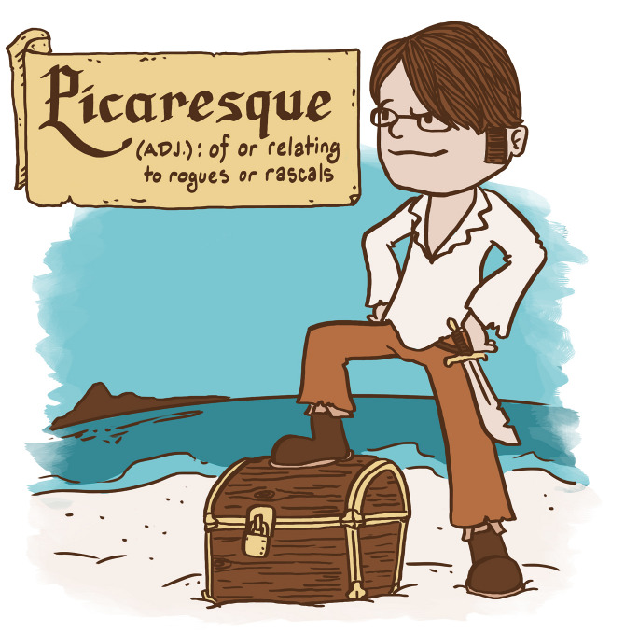
PICARESQUE NOVELS
-Dr. Santoshi Bhawani Mishra
Assistant Professor
Magadh Mahila College

Slide 2
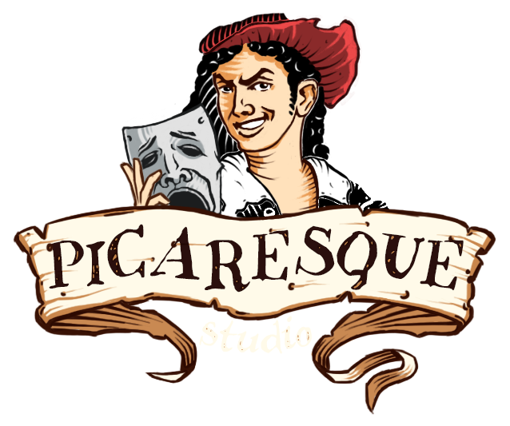
ORIGIN OF THE WORD
The word ‘picaresque’ has been derived from the Spanish word ‘picaro’ which means a ‘rogue’ or ‘knave’.
The word ‘picaro’ is again adopted from ‘picard’.

Slide 3
What is it?
The picaresque novel is a genre of prose fiction that depicts the adventures of a roguish, but "appealing hero",
of low social class,
who wanders from one country to another, enabling the novelist to introduce a variety of characters and incidents.

Slide 4
What’s in a name?
This style of novel originated in Spain in 1554 and flourished throughout Europe for more than 200 years, though the term "picaresque novel" was only coined in 1810.

Slide 5
CHIEF FEATURES :
Picaresque novels typically adopt a realistic style, with elements of comedy and satire.
It has a picaro or a semi-criminal as its central figure who has to shift for himself to earn his living.
He is born of poor and degraded parents or he is illegitimate.
There is no plot. The story is told in a series of thrilling events only loosely connected together by the fact that the same central character figures in them all.
The plot is episodic and the incidents thrilling and sensational.
A picaresque narrative is usually written in first person as an autobiographical account.
There is little if any character development in the main character. Once a pícaro, always a pícaro.

Slide 6
The pícaro's story is told with a plainness of language or realism.
Satire is sometimes a prominent element. The aim of the novelist is to delight and entertain and not to reform or improve.
The behavior of a picaresque hero or heroine stops just short of criminality. Carefree or immoral rascality positions the picaresque hero as a sympathetic outsider, untouched by the false rules of society.

Slide 7
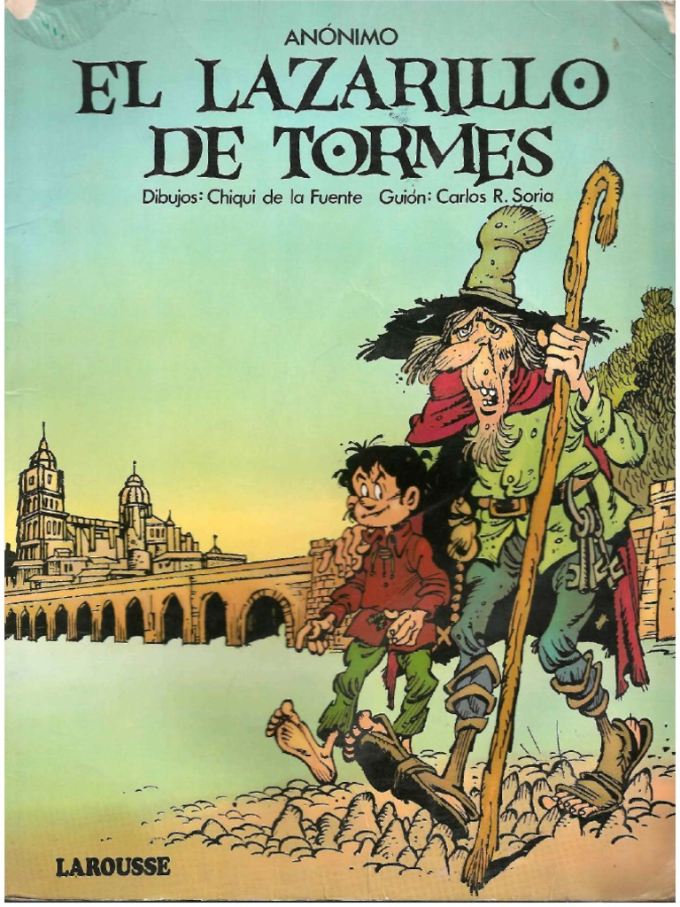
‘Lazarillo de Tormes’
is a Spanish novella, published anonymously because of its anticlerical content in 1554.
It is variously considered either the first picaresque novel or at least the antecedent of the genre.

Slide 8
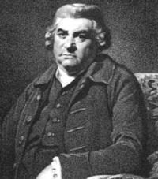
‘The Unfortunate Traveller’
or, the ‘Life of Jack Wilton’ is a picaresque novel by Thomas Nashe (1567-1601) first published in 1594 but set during the reign of Henry VIII of England.
It is often cited as one of the earliest examples of an English picaresque novel.

Slide 9
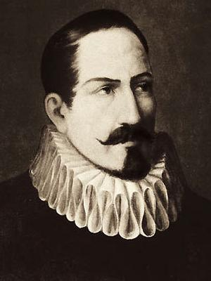
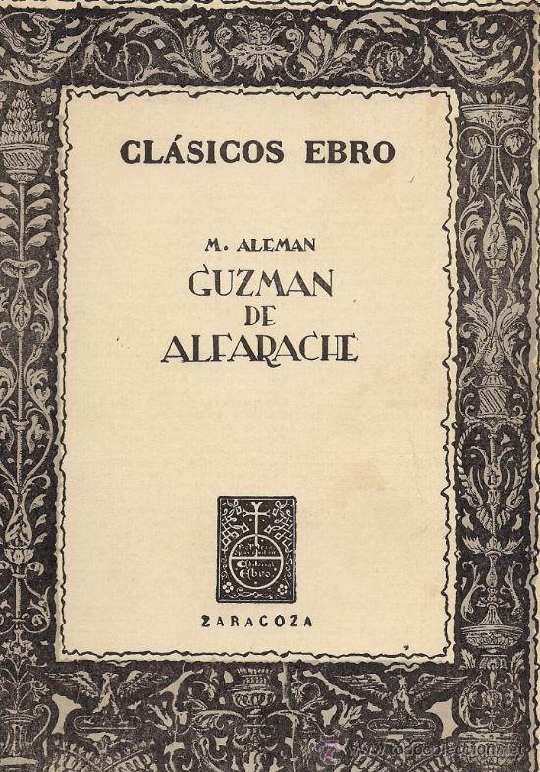
‘Guzmán de Alfarache’
Another early example is Mateo Alemán's Guzmán de Alfarache (1599), characterized by religiosity.

Slide 10
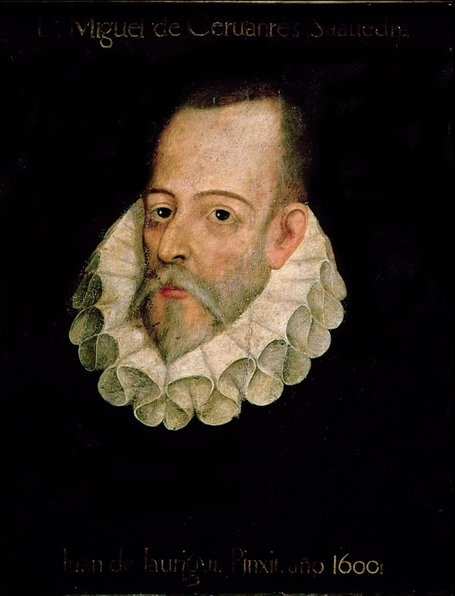
‘Don Quixote’
is a Spanish novel by Miguel de Cervantes Saavedra (1547-1616), published in two volumes, in 1605 and 1615. The "single most important progenitor of the modern novel", that M. H. Abrams has described as a "quasi-picaresque narrative".

Slide 11
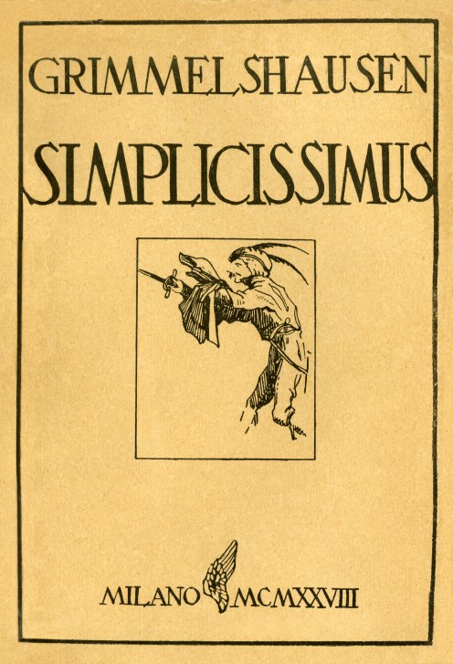
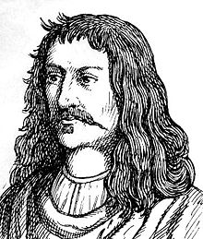
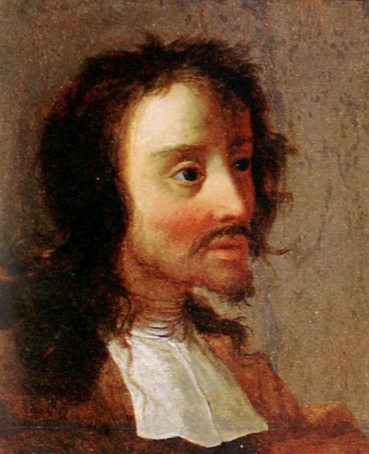
‘Simplicius Simplicissimus’
is a picaresque novel of the lower Baroque style, written in 1668 by Hans Jakob Christoffel von Grimmelshausen (1621-1676) and probably published the same year (although bearing the date 1669). It describes the devastation caused by the
Thirty Years' War.

Slide 12
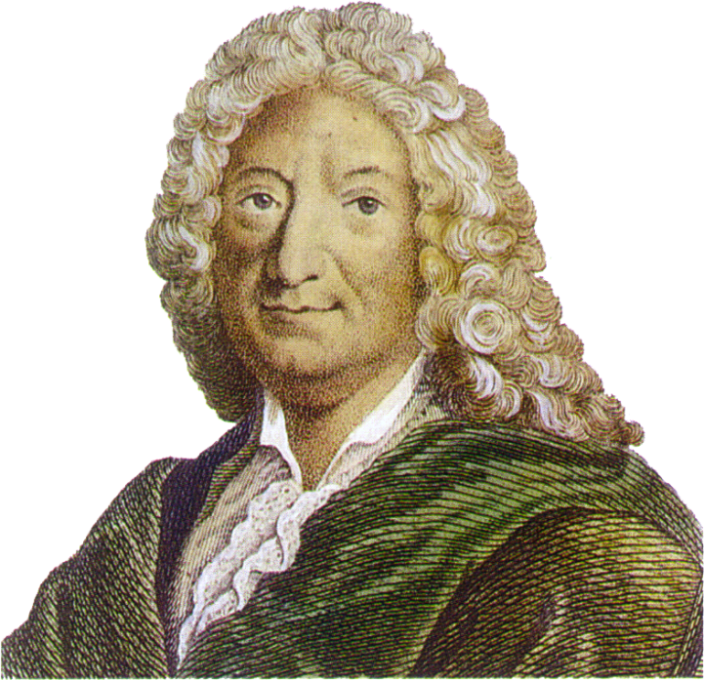
‘Gil Blas’
is a picaresque novel by French novelist Alain-René Lesage (6 May 1668 – 17 November 1747) published between 1715 and 1735. It exercised the profoundest influence on the Picaresque Novels in England.

Slide 13
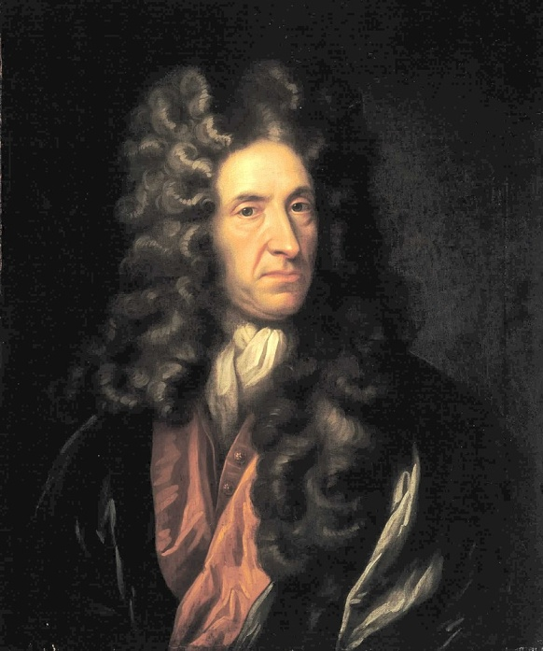
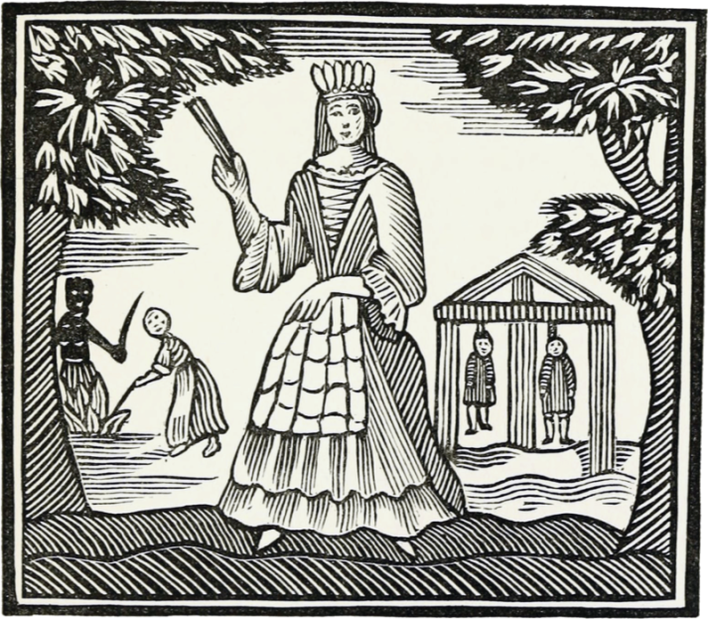
‘Moll Flanders’
is a novel by Daniel Defoe (1660-1731), first published in 1722. It purports to be the true account of the life of the eponymous Moll, detailing her exploits from birth until old age.
This novel enlarged the scope of this genre as it depicts the life of a dissolute heroine and not of a hero.

Slide 14
‘TOM JONES’
‘The History of Tom Jones, a Foundling’, often known simply as ‘Tom Jones’, is a comic novel by English playwright and novelist Henry Fielding, first published in 1749.
It is both a Bildungsroman and a picaresque novel.
It totals 346,747 words divided into 18 smaller books, each preceded by a discursive chapter, often on topics unrelated to the book itself.
It is dedicated to George Lyttleton.
The novel is highly organized, despite its length.
It became a best seller, with four editions being published in its first year alone.
Tom Jones is generally regarded as Fielding's greatest book and as a very influential English novel.

Slide 15
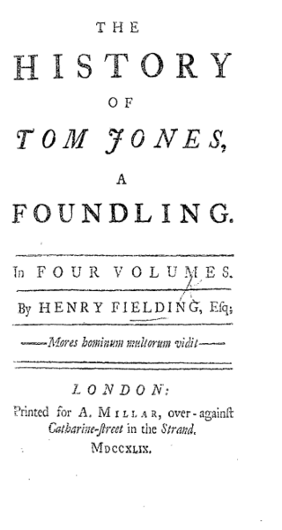
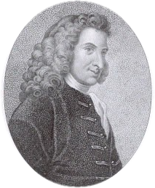
HENRY FIELDING (1707-1754) is known for his rich, earthy humor and satirical prowess, and as the author of the picaresque novel TOM JONES.

Slide 16
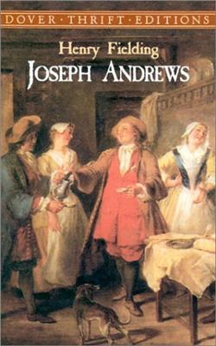
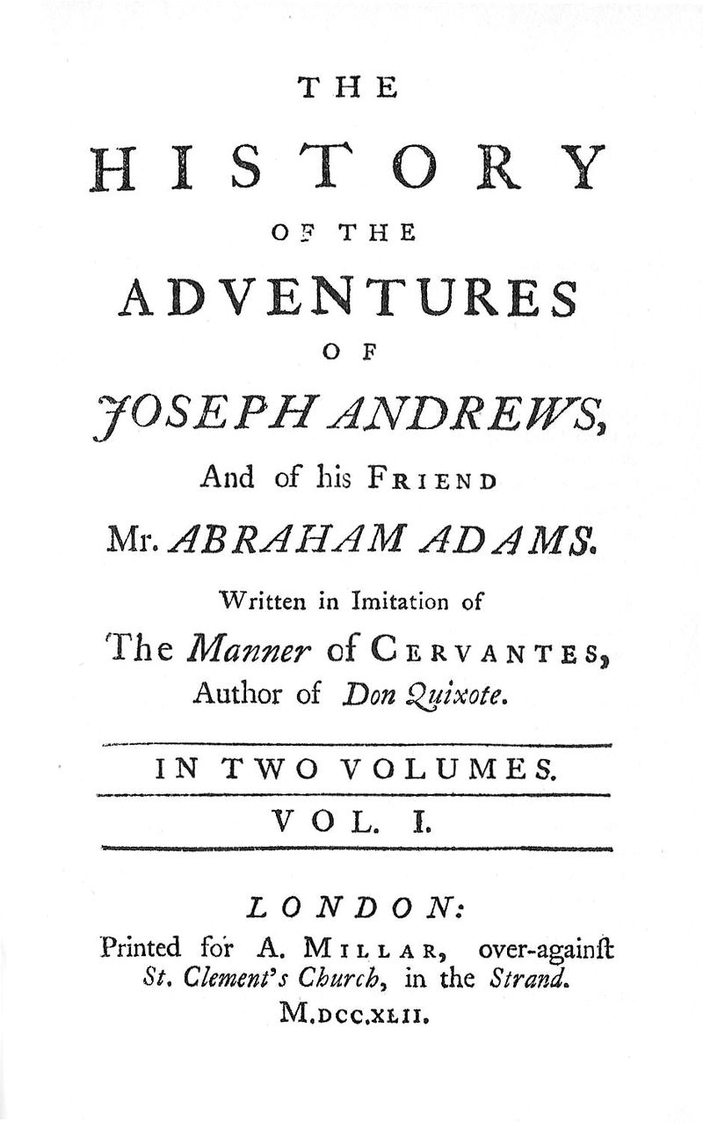
‘JOSEPH ANDREWS’
‘Joseph Andrews’ , or ‘The History of the Adventures of Joseph Andrews and of his Friend Mr. Abraham Adams’ (1742), was the first published full-length novel of the English author Henry Fielding, and indeed among the first novels in the English language.

Slide 17
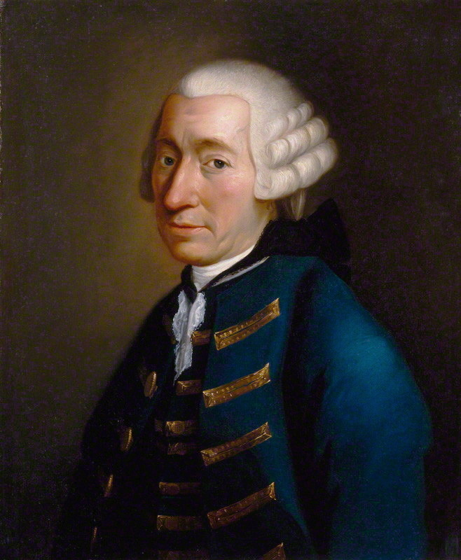
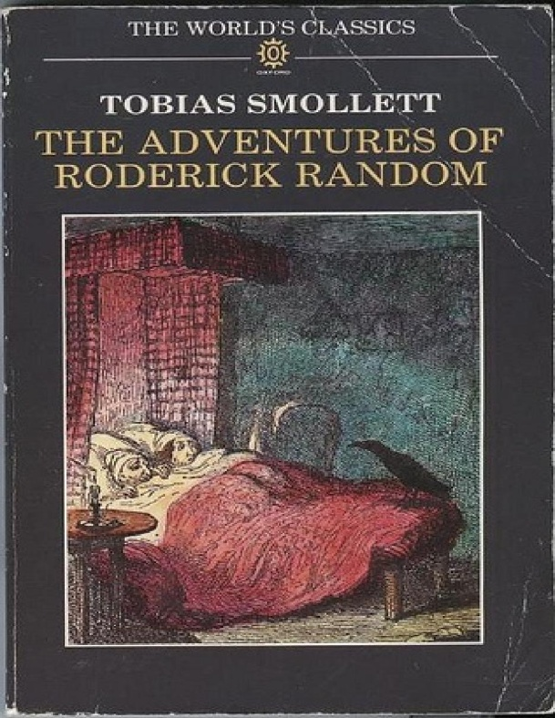
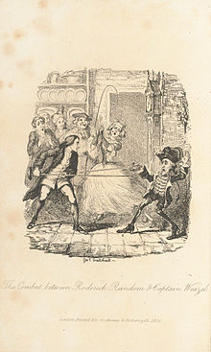
‘RODERICK RANDOM’
‘The Adventures of Roderick Random’ is a picaresque novel by the Scottish author - Tobias George Smollett (1721-1771), first published in 1748.

Slide 18
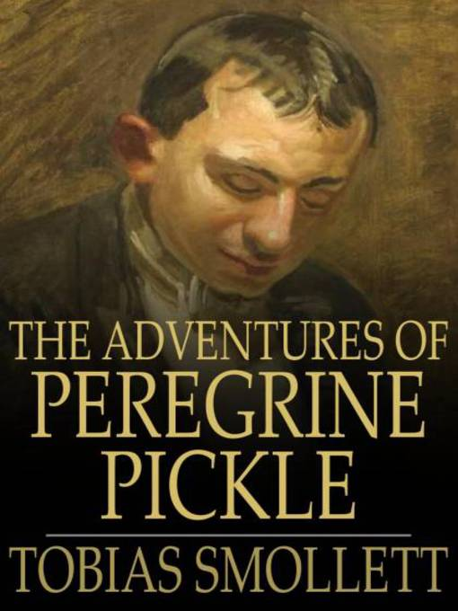
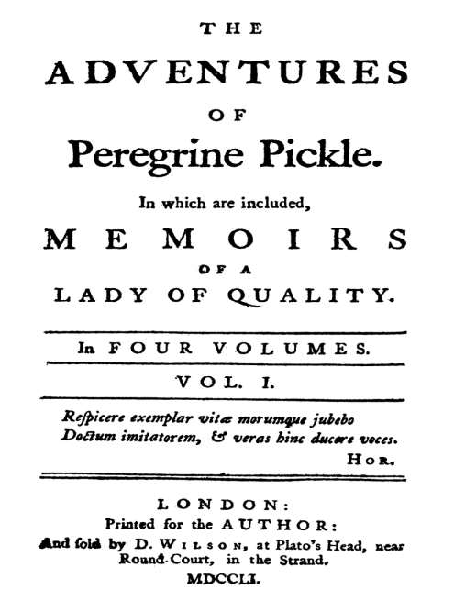
‘PEREGRINE PICKLE’
‘The Adventures of Peregrine Pickle’ is another picaresque novel by the Scottish author Tobias Smollett (1721–1771), first published in 1751 and revised and published again in 1758.
It tells the story of an egotistical man who experiences luck and misfortunes in the height of 18th-century European society.

Slide 19
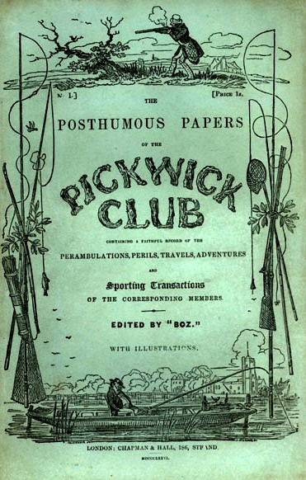
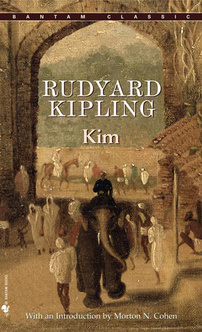
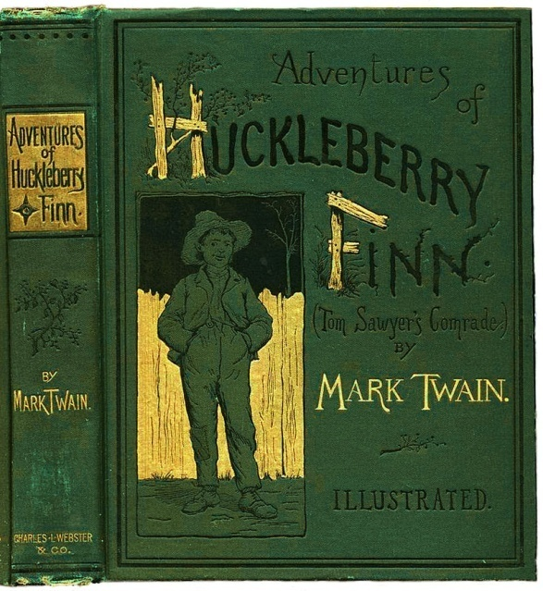
Some more on the same:
Elements of the picaresque are found in Charles Dickens’s The Pickwick Papers (1836–37).
Mark Twain's Adventures of Huckleberry Finn (1884) was consciously written as a picaresque novel.
Rudyard Kipling's Kim (1901) combined the influence of the picaresque novel with the modern spy novel.

Slide 20
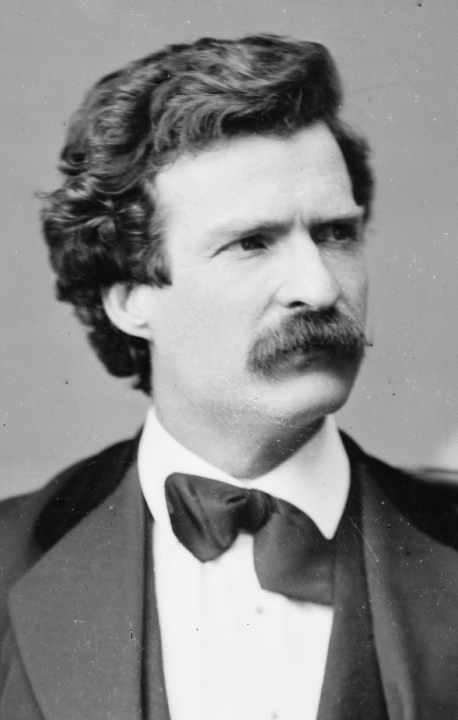
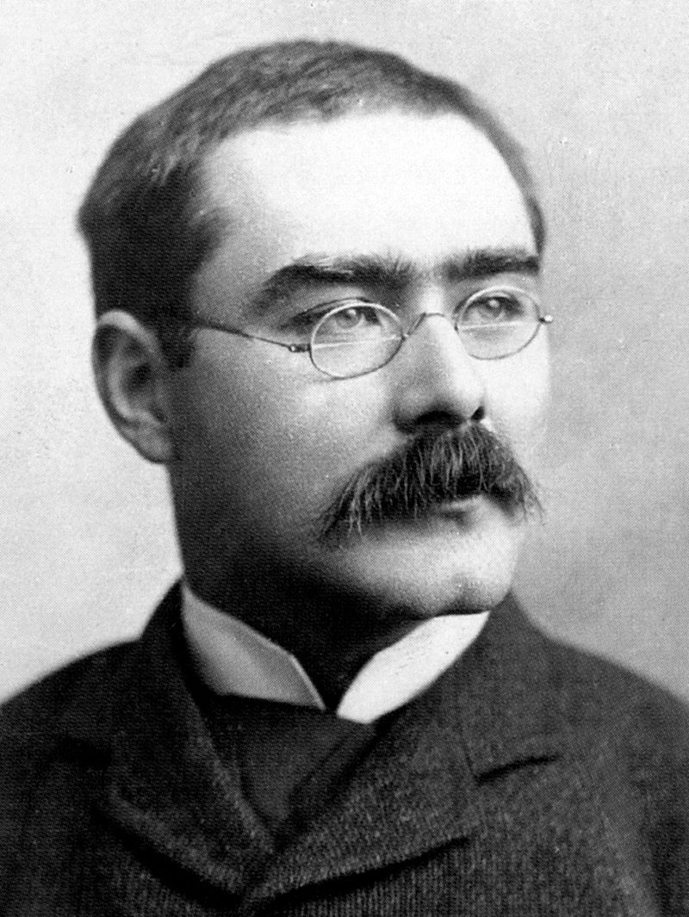
Charles John Huffam Dickens (1812-1870)
Samuel Langhorne Clemens (1835-1910), better known by his pen name
Mark Twain.
Joseph Rudyard Kipling
(1865-1936)

