Slide 1
Magadh Mahila College
Patna University, Patna
North Gandhi Maidan, Patna – 800 001
Dr. Shukla Mohanty
Hon’bleChairperson
Dr. Aprajita Chawdhary
Member Coordinator
Dr. Varinder Kaur Thind
Member

Slide 2
We the family of
Magadh Mahila College
Extend our Warm Regards
to
Eminent Academicians
of
NAAC Peer Team
Prof. (Dr.) Shashi Sharma
Principal
University Professor
Dept. of Political Science

Slide 3
About the College
Magadh Mahila College, a pioneer institution of higher education for young women in Bihar was established in 1946. A constituent unit of Patna University, possessing a permanent affiliation under section 2(f) &12B of UGC Act since 1952 and reaccredited with ‘A’ grade (3.02 CGPA) by NAAC in January 2013, it is imparting education to 3500 students in various disciplines. It has been awarded College with Potential for Excellence (CPE) Status by the UGC, New Delhi for 2011-16 and has retained the status of CPE till 2021.

Slide 4
Upcoming Highlights
2019 is the year of 74th establishment year of this august Institution and next year we are going to celebrate our Platinum Jubilee.
The highlights of the celebration will be handing over G+7/639 bedded fully furnished hostel for the students by the Hon’ble Chief Minister of Bihar, Shri Nitish Kumar.

Slide 5
PROFILE
Year of Establishment : | 1946
A Constituent Unit of Patna University
College with Potential for Excellence [CPE] Status Accorded by UGC for has retained the status till | 2011-2016 2021
2nd Cycle NAAC Accredited ‘A’ Grade with CGPA | 3.02
Programme Offered | 44
Courses Offered | 4 (UG/ PG/ Diploma/ Certificate)
Permanent Faculty Members | 47
Guest Faculty appointed by the University | 10
Guest Faculty on Contract Basis | 22
Guest Faculty in various Self-financing Courses | 77
Permanent Support Staff : | 28
Temporary | 45
Student Strength | 3393
Area of Campus : | 09 Acre

Slide 6
Sustainable Green Campus
The College is situated beside river Ganga which bestow a pious and peaceful environment to the campus
The ecofriendly approach of the teachers, staff, students and vendors adds a gracious aura to the campus
The Wi-Fi enabled, clean & green campus of the College attracts the attention of each person visiting the institution
The flora and fauna conserved on the campus are the specificity of the institution

Slide 7
VISION
To be leader in the field of education by providing innovative learning, environment and women empowerment with traditional values to bring qualitative change in the society
To give direction to students to accomplish self-learning with Indian values , openness and creativity to sustain themselves in the changing societal and economic environment
On the banks of Holy Ganga, the College provides perennial flowing environment of self-learning, to become flexible to meet the women centric challenges by inculcating innovative educational methods
Empowering girl students with knowledge and skill to enable them to cope up and compete with demands of modern age .To develop leaders with new ideas and capacity to make difference in themselves and society by upholding values of respect and humanism
To be the Centre of excellence in education, skill development and lifelong learning

Slide 8
Mission
Magadh Mahila College is committed to the holistic development of women so as to make an effective contribution to creation of healthy society . To this end we strive:
To become a Centre of Excellence in Higher Education for women in healthy environment
A stimulating learning environment through new and innovative academic programmes
Empowering students through knowledge and skills to enable them to cope and compete with the demands of modern age
To create women leaders and to make them agents of social change
Culturally rich environment linking education to the outside world
To provide dedicated and responsive scholars as faculty

Slide 9
Core Values
Discipline
Dedication
Sincerity
Honesty
Inclusiveness
Humanity
Indian Values,
Ethics and
Culture of Team-work

Slide 10
The Recommendations
Made by NAAC Peer Team
Visited on 11th -13th October 2012 For 2nd Cycle Assessment and Accreditation
The recommendations of PEER TEAM during its visit for 2nd Cycle in which our institution was accredited with Grade A have been strictly honoured and adhered to. We have taken care of all those recommendations which have been executed in toto

Slide 11
Criterion-I Curricular Aspect

Slide 12
ACADEMIC PROGRAMMES
Curricular Aspects
Level of the Programme | Number of existing Programmes | Number of programmes added during the year 2018 | Number of self-financing programmes | Number of value added / Career Oriented programmes
Ph.D. | 01 | 0 | 0 | 0
PG | 5+1* | 0 | 1* | 6
UG | 21+5* | 0 | 5* | 26
PG Diploma | 2* | 0 | 2* | 2
Certificate | 4* | 7* | 11* | 11
Total | 38 | 6 | 18 | 45
*Self Financing

Slide 13
Academic Flexibility
CBCS (Semester System) has been introduced in Post Graduate Programmes (M.A./M.Sc.) by the University since 2018-19 Session
CBCS has been introduce in BCA, BBA and BSW by the University since 2019-20 Session.
Semester System has been introduced in PG Diploma Courses since 2018-19 Session.
In conventional U.G. Courses students have the flexibility of choosing composition paper out of
Hindi-50 and English-50/Urdu -50/Maithili-5/Persian -50
Hindi -100
P.G. in Herbal Chemistry is running in the college since 2008 which has been introduced by the UGC as an innovative Programme.

Slide 14
Skill Development Programmes
Entrepreneurship Development Training:
Establishment of an ‘Incubation Centre’ to prepare skilled young entrepreneurs for business incubation by the College
A MOU has been signed with ATAL INCUBATION CENTRE supported by NITI Aayog, Government of India
Another MOUs has been signed with Confederation of Indian Industries (CII) & Indian Institute of Entrepreneurship Development
Soft Skill Stream
Certificate Courses in German Language Proficiency Programme.
Certificate Courses in English Language Proficiency Programme.
Computer Skill
Certificate Course in SPSS & OriginPro
Certificate Course in Web Designing
Certificate Course in Medha Learning on LAB, TAB & CAB
Management Skills
Certificate Course in Office Management

Slide 15
Curriculum Enrichment
12 New Programs introduced during last 5 years
Curricular revision linked to the feedback of stakeholders
Seminars, Workshops and Extra-mural lectures
English Communication Skill
Skill development Programme introduced
Incubation Centre
However curriculum design and enrichment is sole discretion of University in our structure but within given liberty we have tried our level best to include much of innovation in curriculum to make our students compete with global standard.

Slide 16
Criterion-II
Teaching Learning & Evaluation

Slide 17
The Strength – At a Glance
Teaching –Sanctioned Posts : 81
Permanent Faculty Working : 47
University Professor : 05
Associate Professor : 19
Sr. Asst. Professor : 03
Assistant Professor : 20
Assistant Professor
(Guest Faculty) : 10
Ad-hoc Teachers : 22
Guest Faculty
(Self-financing Courses) : 77

Slide 18
Information Regarding Teaching Staff
Teaching, Learning and Evaluation

Slide 19
Support Staff- At a Glance
Sanctioned Posts : 86
Permanent Staff Working : 28
Ad-hoc Staff Working : 41
Outsourcing Staff : 25

Slide 20
Teachers From Other State
Teaching, Learning and Evaluation
Name Of Full Time Teachers From Other State | State From Which Qualifying Degree Was Obtained
Dr. Anju Srivastava(Home Sc.) | M.S. Univ. of Baroda, Gujrat
Dr. Neera Chaudhary(Music) | B.H.U., U.P.
Dr. Suraj Deo Singh(Urdu) | J.N.U., New Delhi
Dr. Janardan Prasad (Economics) | Jharkhand, Ranchi Univ.
Dr. Shweta Sharan(Economics) | Ranchi University, Jharkhand
Dr. Mamta Deepak(Retd.)(Physics) | Uttar Pradesh
Dr. Manish Kr. Verma(Physics) | Univ. of Delhi, Delhi
Dr. Priti Mishra (Physics) | TIFR, Maharashtra
Ms. Sonu Rani (Physics) | Univ. of Delhi, Delhi
Dr. Ranjana Yadav(Philosophy) | B.H.U., Uttar Pradesh

Slide 21
Teachers From Other State
Teaching, Learning and Evaluation
Name Of Full Time Teachers From Other State | State From Which Qualifying Degree Was Obtained
Dr. Amrita Prasad (Chemistry) | B.H.U., U.P.
Dr. Bina Rani (Chemistry) | Ranchi University,Jharkhand
Dr. Anjum Fatima (Chemistry) | Uttar Pradesh
Dr. Rajni Pandey (Home Sc.) | CCSHAU, Haryana
Dr. Sujata Kumari (Zoology) | B.H.U., U.P.
Dr. Binay Kumar (Mathematics) | GNDU, Punjab
Dr. T. Meena Horo(Pol. Sc.) | Jharkhand
Dr. Khushboo (English) | Ranchi University, Jharkhand
Dr. Santoshi B. Mishra (English) | B.H.U., U.P.

Slide 22
Students Enrolment Process
Admission through PUCET (Patna University)
Admission details in on-line prospectus
Advertisement in Print ,Electronic media & Website
On-line submission of Application forms
Publication of selection list by admission portal of College
Website message alert from College
Merit List Publication in website
Counselling & Admission
For PG Courses selection on Merit basis by the College

Slide 23
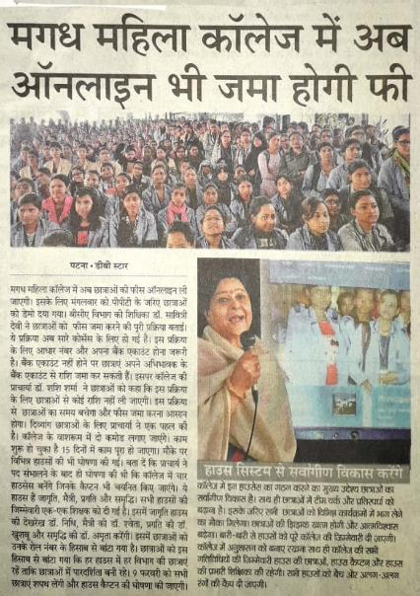
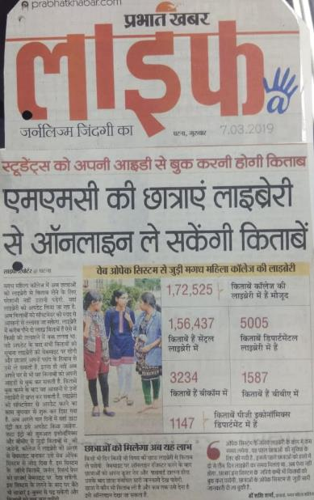
Media Reports for Online Fee Collection

Slide 24
Admitted Students in Part - I : Yearwise –(2014-2019 )

Slide 25
Foreigner Student Admitted in Department of Psychology
Name : Benegui Maria Emilia
Country : Romania
Subject : PG Psychology Session : 2018-20

Slide 26
Teaching - Learning Process
Academic Calendar is followed
Department wise Plan & Progress Registers are maintained
Apart from Lecture Method, Practical Classes/Field Study/ Industrial Visit/Science Exhibition/Group Discussion/ Extempore/ Seminar/ Symposia /Workshops /Study Tours are also conducted
ICT Teaching
E-learning, Virtual Groups (WhatsApp)
Co- Curricular activity for holistic development
Dance/Music/Drama/Fine Art for nurturing creativity
Terminal Examinations and Internal Evaluation for UG students and CIA (Continuous Internal Assessment) for PG students
Study Materials & Web links
Mentoring Program
Project Preparation & Power Point Presentation under CPE Scheme

Slide 27
Student Diversity
At entry level, after personal interaction, students are identified as
SLOW LEARNERS
During the first fifteen days of the new academic session, department wise basic concept of subjects are discussed in the form of Bridge Courses so that beginners have an initial idea of the subjects
Department wise remedial classes are conducted
Extra Classes are conducted
Teacher’s Assistance in accessing the departmental / central library
Mentoring Programme

Slide 28
Student Diversity
At entry level, after personal interaction, students are identified as –
ADVANCED LEARNERS
Mentoring Program and Career Counseling Cell are used for identifying learning needs and helping them accordingly
Guidance and solution of previous question papers of University exams are provided
They are motivated to participate in various projects and scholarship schemes
They are encouraged to participate in seminars for personality development
Students are made to participate in various departmental activities
Students are encouraged to actively participate in co-curricular activities which are organized both inside and outside the campus

Slide 29
University Exam Result 2018 & 2019

Slide 30
University Examination Result -2019

Slide 31
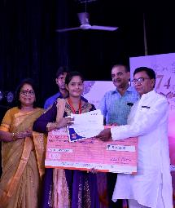
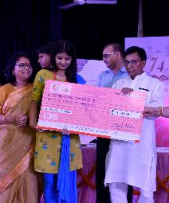
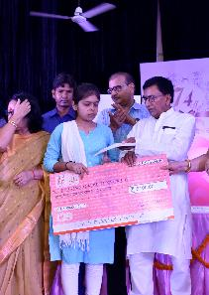
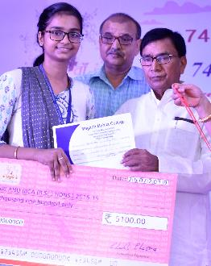
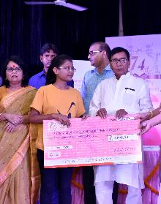
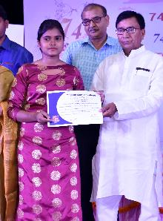
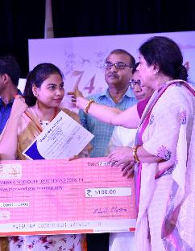
Gold Medalists 2019 In University Examination
GOLD MEDALISTS 2018 IN UNIVERSITY EXAMINATION

Slide 32
Gold Medalists 2018 In University Examination

Slide 33
Innovative Processes Adopted In Teaching And Learning
Teaching ,Learning & Evaluation
Use of ICT in Teaching-Learning Department wise Classroom Seminars/ Symposia/ Group Discussions/ Workshops for students’ Soft Skill enhancement Organizing Power Point Present Programmes for students Organizing Soft Skill Training Programmes Guest lectures on several current / relevant issues Organizing and participation in Seminars, Conferences and Workshop and participation in other institution Quiz competition conducted by the departments Debate and Group Discussions conducted by departments Mentoring system is in practice

Slide 34
Glimpses Of Our Endeavours
Seven Certificate Courses have been been introduced in 2018
Four (4) Three Months Certificate Courses in Fine Arts Stream
1. Madhubani Painting
2. Block Printing
3. Tikuli Art
4. Jute Art, Craft and Design
Three Six Months Certificate Courses:
1. Office Management
IT & Web Designing
Medha Learning- LAB, TAB & CAB

Slide 35
Seven Certificate Courses has been introduced in 2018-19
Jute Art, Craft & Design
Tikuli Art
Madhubani Printing
Web Designing
CCCA
Certificate Course in Computer Application
Office Management

Slide 36
Medha Learning LAB-TAB - CAB Courses

Slide 37
Key Metrics
We have registered 80 students to our Career Advancement Bootcamp (CAB) and Life Skills Advancement Bootcamp (LAB) program this year. These students will take 30-hour long classes which involves both in-and-out of classroom activities, industry exposures visits, career counseling and mentoring
70 students were taken to industry exposure visits and we plan to organize 4 more exposure visits in November 2019.

Slide 38
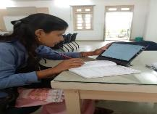
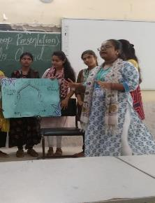
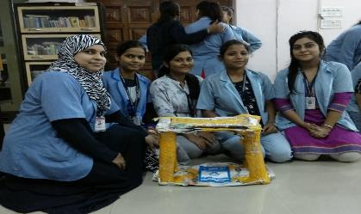
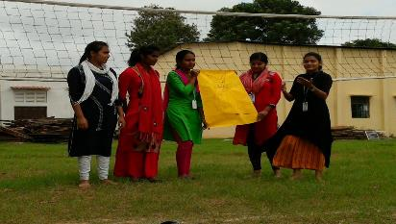
LEARNING BY DOING
Medha students are encouraged to take charge of their own learning by participating in in-and-out classroom sessions and lessons. Our Career Advancement Bootcamp (CAB) and Life Skill Advancement Bootcamp (LAB) programs focus on experiential learning.
Experiential learning is learning through participation, and we encourage students to actively engage with learning and collaborate amongst themselves to develop themselves and their skill together.

Slide 39
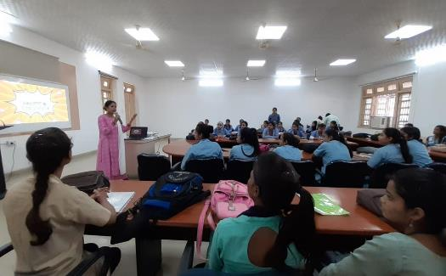
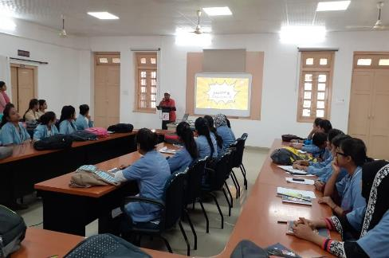
Industry Talk with Indian
Red Cross Society
Ms. Vandana Singh, D.C, Indian Red Cross Society and Dr Shrawan Kumar Singh visited the college for an industry talk for the students and educated them about the Development Sector.
During this interactive session, the representatives from Red Cross made the students aware about opportunities and challenges in Development Sector and Disaster Management and told them about the entry level jobs available and eligibility to achieve them.

Slide 40
Lecture on Gender Sensitization

Slide 41
National Science Day Celebration
Celebration of National Science Day

Slide 42
State Level Kaushal Vikash Competition

Slide 43
125th Birth Anniversary of Prof. S. N. Bose
Lecture by Dr. Utpal Roy, Prof. Physics, IIT Patna

Slide 44
7 Days National Workshop in Dept. of Music

Slide 45
Criterion-III
Research, Innovation and Extension

Slide 46
INITIATIVES OF IQAC
Research, Innovations And Extension
IQAC promotes faculty members to register for research programmes and Ph.D. There is provision of study leave for such programmes Increase the number of Research guides and Research students Directed the departments to submit proposals to UGC for National Seminars/ Workshops Encourages teachers to present and publish papers in response to 'Call for Papers' Facilitates the function of well-equipped research laboratories in various departments that aids in the projects of U.G and P.G Aided in the Orientation programmes conducted by library for students Facilitated Journal review programme through Library

Slide 47
RESEARCH PROGRAMME
Research, Innovations And Extension
Present Research Study by Dr. Pushplata Kumari
Title of the project | Duration | Sponsored / funded by institution | Year of Completion | Budget Sanctioned | Report submitted / year
Minor Research Project- “A Study on Assessing the Awareness Level of Women and Adolescent Girls towards Criminal Law (Amendment) Act, 2013 and Sensitivity of Bureaucracy in its Effective Implementation” | 2018-2019 | ICSSR, New Delhi | On Process | 2,10,000.00 | On going

Slide 48
RESEARCH PROGRAMME
Research, Innovations And Extension
Present Research Study by Dr. Amrita Prasad
Title of the project | Duration | Sponsored / funded by institution | Year of Completion | Budget Sanctioned | Report submitted / year
“Development of Novel Molecularly Imprinted Polymer based extracting devices for isolation and separation of certain biologically active compounds from plant matrices” | 2019-21 | UGC Start- Up | On Process | 10,00000.00 | On Going

Slide 49
Extension Activity & Institutional
Social Responsibility
State level talent recognition awards by NCC/NSS
Extension activities by NCC
Self defense Programme for Girls
Outreach Programme (teaching in nearby Schools)
Computer training to children
Tree plantation
Science / Ozone / Environmental etc. days
Disaster Management Training
Alumnae contribution
Beti Bachao & Beti Padhao Abhiyan
Bal Vivah & Dahej Virodhi Abhiyan
Swachha Bharat Abhiyan

Slide 50
Criterion-IV
Infrastructure & Learning Resources

Slide 51
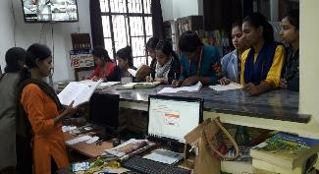
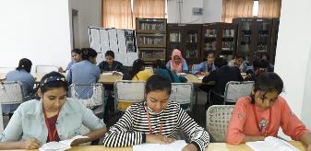
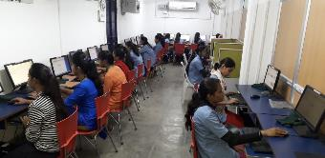
MEDHA Knowledge Centre
Library with High Speed Internet connectivity with LAN
Built up area : 11857 Sq. Ft
Newspapers and NLIST-INFLIBNET facility, OPAC facility for searching the library resources,
Issue and Return of books : KOHA
Books in Central Library : 1,55, 643
Central Library Journals/ Periodicals/ Magazines : 13
Central Library Newspaper : 05
Books in B.Com & BBA Library : 4821
Books in BCA Library : 4734
BCA e- books : 256
BCA e-journals : 01
Books in BSW Library : 381
Books in Library Economics PG : 1147
Books in Departmental Libraries : 5005
Total : 1,72006

Slide 52
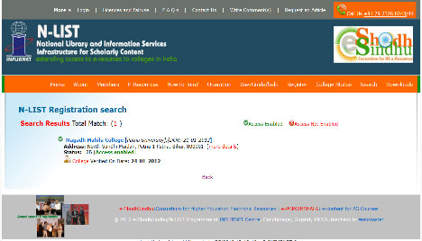
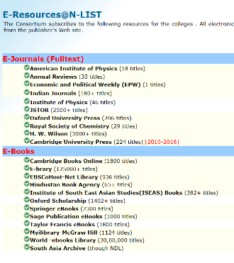
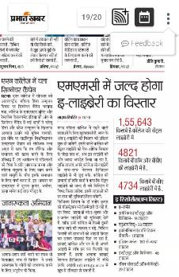
e-Resources
Subscription of
6000+ e-journals,
31,35,000+ e-books,
Sodhganga,
e-sodhsindhu through the subscription of
N-LIST since 2012
Remote access enabled through login of registered students on the NLIST portal

Slide 53
Science Laboratory Botany
Refrigerator
Digital Balance
Deep freezer
LAMINAR AIR FLOW
Autoclave

Slide 54
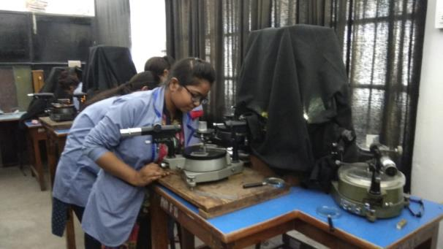
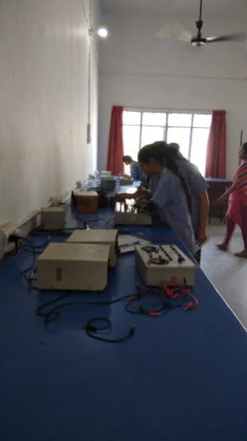
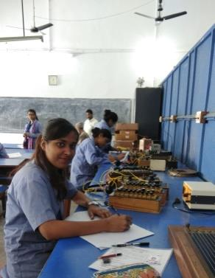
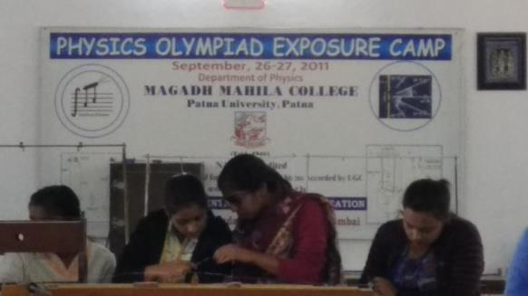
Science Laboratory Physics
Spectrometer
Solid state and Electronics Lab
Mechanics Lab

Slide 55
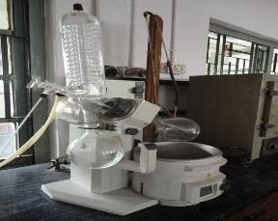
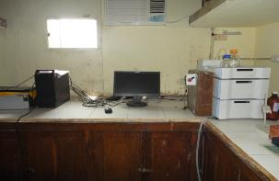
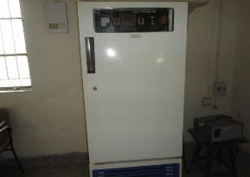
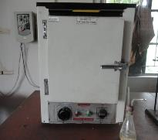
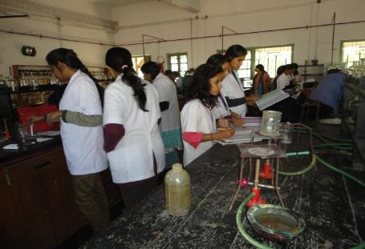
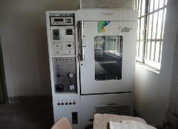
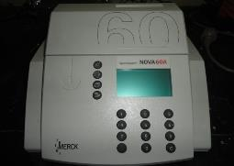
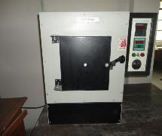
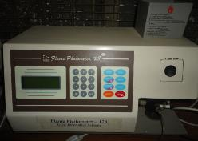
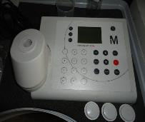
Science Laboratory Chemistry
Rota Vapour
High Performance Liquid Chromatography
B.O.D. Machine
Oven
Plant Growth Chamber Machine
Muffle Furnace
Spectroquant Photometer NOVA 60
Spectroquant MultiPhotometer
Flame Photometer

Slide 56
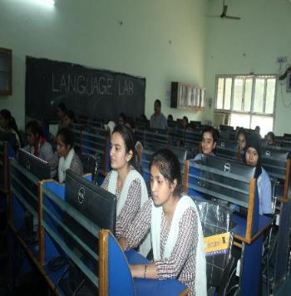
BCA LAB, e-LIBRARY & LANGUAGE LAB
LEARNING RESOURCES
Language Lab was established in the College with a vision to empower every student with fluency in English and develop oratory skills with powerful vocabulary. Since its inception the students have utilized it to the fullest in order to update themselves in competitive arena.

Slide 57
STUDENTS’ COMMON ROOM WITH ADEQUATE FACILITY
Initiatives & Implementation

Slide 58
RECESS LOUNGES

Slide 59
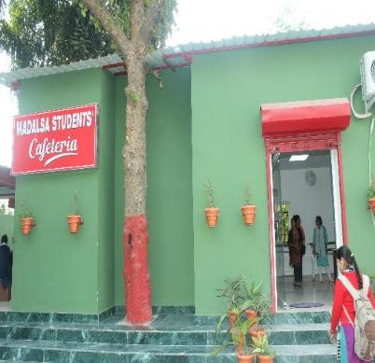
MADALSA STUDENTS’ CAFETERIA
Glimpses of Infrastructure Development

Slide 60
DRINKING WATER FACILITY IN CAMPUS
RO- WATER FOR STUDENTS AND VISITORS
RO-WATER FOR
STUDENTS

Slide 61
LIFT FOR P H STUDENTS
Glimpses of Infrastructure Development
METALLIC STAIRCASE

Slide 62
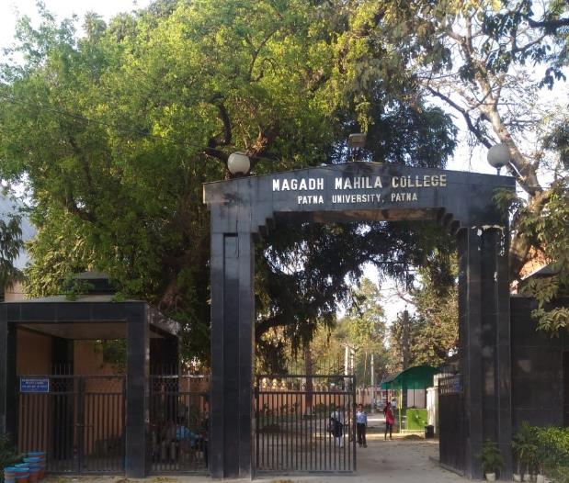
B. Com. & BBA BUILDING
MAIN GATE

Slide 63
TWO FLANKS OF GROUND FLOOR CORRIDOR
Glimpses of Infrastructure Development

Slide 64
TWO FLANKS OF 1ST FLOOR CORRIDOR

Slide 65
CONFERENCE HALL
Glimpses of Infrastructure Development

Slide 66
100 KWp SOLAR POWER PLANT

Slide 67
Glimpses of Infrastructure Development
INFIRMARY
RAIN WATER HARVESTING UNIT
DAY CARE CENTRE
MAIN ELECTRICAL PANEL ROOM
GREEN GENERATOR

Slide 68
Zoological Park
Promoting Green Initiatives at MMC Campus

Slide 69
Aquarium
Promoting Green Initiatives At MMC Campus

Slide 70
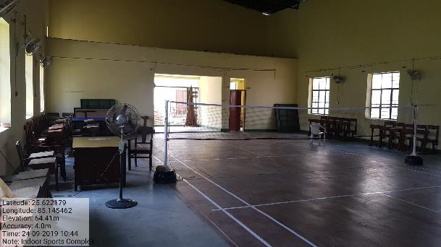
SPORTS
Indoor Sports Complex
Sports Ground with Pavellian

Slide 71
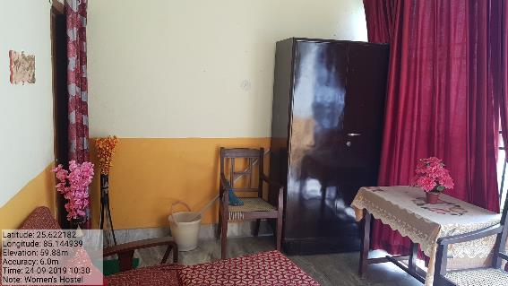
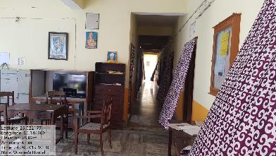
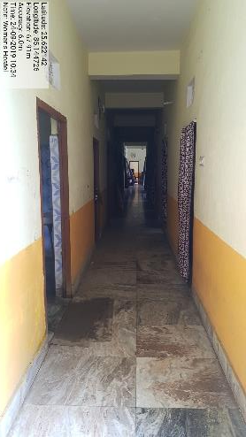
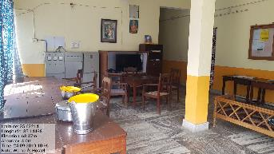
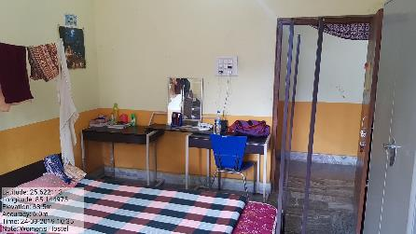
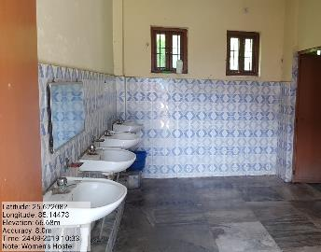
Glimpse of Campus Hostels

Slide 72
Criterion-V
Student Support and Progression

Slide 73
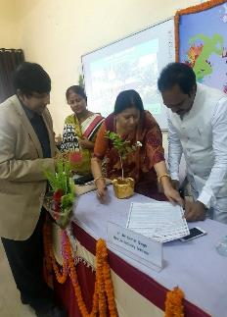
INCUBATION CENTRE AT MMC
Glimpses of Infrastructure Development

Slide 74
CAREER AND COUNSELLING CELL PLACEMENT CELL
Details of Placement (Year wise)
Sl. No. | Year | No of students selected
1 | 2018-19 | 123
2 | 2017-18 | 78
3 | 2016-17 | 92
4 | 2015-16 | 88
5 | 2014-15 | 406
6 | 2013-14 | 141
7 | 2012-13 | 52

Slide 75
CAREER AND COUNSELLING CELL MAGADH MAHILA COLLEGE
Companies visited in College
Wipro India Pvt Ltd | SAP | Indigo
Concentrix India Pvt Ltd | Infosys | Go Air
TCS | Genepact | Jet Airways
Sucessa | Aviva life Insurance | Just dial
Sociatrix | LIC | SBI
IBM Daksh | Samsol Tech Pvt. Ltd. | ICICI Bank
HCL Technology | Reliance Communication | Just Dial

Slide 76
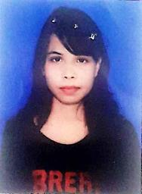
CAREER AND COUNSELLING CELL MAGADH MAHILA COLLEGE
Recruitment
Aditi
Department:- Commerce (B.Com)
College Roll NO. 135
University Roll No. 2312
Session 2016-19
Post :- CSR(Company Service Representative in Concentrix
Package :- 24 Lac.

Slide 77
Students’ Cabinet Election – 2019

Slide 78
Cabinet Oath Taking Ceremony 2019

Slide 79
Students’ Cabinet : Session-2019-2020
Ayesha Khatoon
General Secretary
Anamika Sharma Cultural Secretary
Rajnandani
Common Room
secretary
Rashmi Shankar
Secretary
Environment &Natural Resources
Anita Kumari
Secretary
Sanitation
Shikha Biplow
Sports Secretary
Anshika Kumari
Treasurer
Bhagya Bharti
Secretary – Science & IT Society

Slide 80
Students’ Cabinet : Session-2018-2019
Somya Nandini Asst Cultural Secretary
Priya Bharti
Asst General Secretary
Aditi Priya
Asst Secretary
Environment &
Natural Resources
Amisha Kiran
Asst Secretary
Sanitation
Archita Kumari
Asst Sports Secretary
Simran Singh
Asst Secretary – Science & IT Society

Slide 81
Guidance and Counselling Center
Guidance & counselling Center was inaugurated by Prof. Sanjay Paswan and Prof. Saroj Dube on 8th February 2017 at MMC under headship of Dr. Archana Katiyar (Based on last NAAC team’s suggestion)
Center is providing psychological assessment and psychotherapeutic assistance to college students by RCI registered trained Clinical Psychologist Ms. Nidhi Singh (Asst. Prof.)
Center is also organizing various mental health awareness and sensitization programmes for students

Slide 82
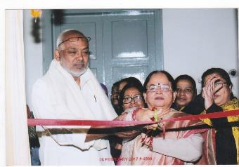
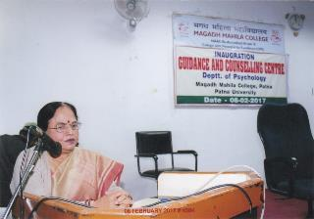
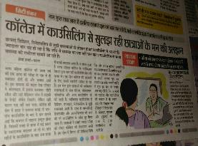
Guidance & Counselling Center’s presence in Media

Slide 83
IMPORTANT PUBLICATIONS 2017-2018
Handbook 2018
JIGYASA–IV
Annual Report
Sahodara Samvad
Prospectus 2018
Srijan 2017

Slide 84
STUDENT OF THE YEAR STUDENT OF THE YEAR 2018 2019
Students’ Achievements

Slide 85
Scholarship (Financial Support by Government)
Year – 2012-13
Sl. NO. | Financial support from government 2012-13 | Number of students | Amount
1 | OFFICE OF THE DISTRICT WELFARE OFFICER DWO, Patna SC/ST Scholarship 2012-2013 Government of Bihar | 3 | 2,90,158/-
Year – 2013-14
Sl. NO. | Financial support from government 2013--14 | Number of students | Amount
1 | OFFICE OF THE DISTRICT WELFARE OFFICER, Patna SC/ST offline Scholarship 2013-2014 | 29 | 175,000/-
Year – 2014-15
Sl. NO. | Financial support from government | Number of students | Amount
1 | OFFICE OF THE DISTRICT WELFARE OFFICER DWO, Patna SC/ST Scholarship 2014-2015 | 62 | 524,171

Slide 86
Scholarship (Financial Support by Government)
Year – 2015-16
Sl. NO. | Financial support from government | Number of students | Amount
1 | OFFICE OF THE DISTRICT WELFARE OFFICER BC-EBC 2015-2016 Post Matric Scholarship , DWO, Patna | 443 | 1,360,867
Year – 2016-17
Sl. No. | Financial support from government | Number of students | Amount
1 | OFFICE OF THE DISTRICT WELFARE OFFICER BC-EBC 2016-2017 Post Matric Scholarship , DWO, Patna | 18 | 126451/-

Slide 87
Scholarship (Financial Support by Government)

Slide 88
Mukhya Mantri Kanya Uthan Yojana 2018 (Financial Support by Bihar Government )
Total No of Students 807
Amount Sanction - 25000/- ( Twenty-five thousand only )
All Graduate student in 2018
The list of passed out students has been send to the government and the higher authorities do the respective payment which is directly credited in the student’s account.

Slide 89
Bihar Students Credit Card Scheme 2018
Sl. NO. | Fee description | Total No of Applicant | Amount
1. | Tuition fees including Hostel Expenses | 32 | 903215
Mukhya Mantri Kanya Uthan Yojana 2018
Sl. NO. | Fee description | Total No of Applicant
1. | Mukhya Mantri Kanya Uthan Yojana | 807

Slide 90
Merit Scholarship 2019
Sl. NO. | Fee description | Total No of Applicant | Amount (Per Student) | Amount
1. | Gold Medalist | 9 | 5100 | 45900
2. | Rank Holder | 36 | 1100 | 39600
Total |  |  |  | 85500
Merit Scholarship 2018
Sl. NO. | Fee description | Total No of Applicant | Amount (Per Student) | Amount
1. | Gold Medalist | 5 | 5100 | 25500
2. | Rank Holder | 22 | 1100 | 24200
Total |  |  |  | 49700

Slide 91
Merit Scholarship funded by Alumnae 2019
UG Course
Sl. NO. | Name of the Scholarship | Funded by | Department | Name of Awardee | Amount
1. | Merit Scholarship | Ms. Sangita | Economics | Jigyasa | 11,000/-
2. | Memorial Scholarship | Madhuri Prasad | Zoology | Divyangna Shree | 15000/-
3. | Memorial Scholarship | Madhuri Prasad | Zoology | Raj Monalisha | 10,000/-
PG Course
Sl. NO. | Name of the Scholarship | Funded by | Department | Name of Awardee | Amount
1. | Merit Scholarship | Ms. Sangita | Economics | Surbhi Sinha | 15,000/-
2 | Merit Scholarship | Ms. Sangita | Economics | Shubha Saurabh | 15,000/-

Slide 92
Merit Scholarship funded by Alumnae 2018
UG Course
Sl. NO. | Name of the Scholarship | Funded by | Department | Name of Awardee | Amount
1. | Merit Scholarship | Ms. Sangita | Economics | Ritika Kumari | 11,000/-
2. | Memorial Scholarship | Madhuri Prasad | Zoology | Shubhangi Deep | 15000/-
3. | Memorial Scholarship | Madhuri Prasad | Zoology | DivyangnaShree | 10,000/-
PG Course
Sl. NO. | Name of the Scholarship | Funded by | Department | Name of Awardee | Amount
1. | Merit Scholarship | Ms. Sangita | Economics | Mugdha Mohini | 15,000/-

Slide 93
Merit Scholarship funded by Alumnae 2017
UG Course
Sl. NO. | Name of the Scholarship | Funded by | Department | Name of Awardee | Amount
1. | Merit Scholarship | Ms. Sangita | Economics | Priyanka Kumari | 11,000/-
2. | Memorial Scholarship | Madhuri Prasad | Zoology | Sofia Yasmeen | 15000/-
3. | Memorial Scholarship | Madhuri Prasad | Zoology | Kajal Kumari | 10,000/-
Merit Scholarship funded by Alumnae 2016
Sl. NO. | Name of the Scholarship | Funded by | Department | Name of Awardee | Amount
1. | Merit Scholarship | Ms. Sangita | Economics | Priya Anand | 11,000/-
2. | Memorial Scholarship | Madhuri Prasad | Zoology | Divya Prasad | 15000/-
3. | Memorial Scholarship | Madhuri Prasad | Zoology | Sofia Yasmeen | 10,000/-
Merit Scholarship funded by Alumnae 2015
Sl. NO. | Name of the Scholarship | Funded by | Department | Name of Awardee | Amount
1. | Merit Scholarship | Ms. Sangita | Economics | Neharika Jaiswal | 11,000/-

Slide 94
MUKTI RANGMANCH AT MMC For Promotion of Performing Arts

Slide 95
NCC Programmes: Republic Day Camp

Slide 96
ANNUAL SPORTS DAY- 16.12.2018
SPORTS 2018

Slide 97
ANNUAL SPORTS- 2018

Slide 98
YOGA

Slide 99
AEROBICS

Slide 100
RAINBOW Dril

Slide 101
TAEKWONDO

Slide 102
ANNUAL DAY 25TH JANUARY, 2019

Slide 103
Republic Day Celebration 2019

Slide 104
‘सहोदरा-The Daughters of Same Mother’

Slide 105
Festival Celebrations
Holi Milan
Saraswati Puja
Iftar Party
Youth Day
Sharadotsav

Slide 106
GYM

Slide 107
MANISHIKA THE REGISTERED ALUMNAE ASSOCIATION

Slide 108
ALUMNAE MEET 2019

Slide 109
ALUMNAE MEET 2018

Slide 110
ALUMNAE OF MAGADH MAHILA COLLEGE
Padma Shree Usha Kiran Khan
Hon’ble Justice Rekha Kumari
Padmabhusan Sharda Sinha
Ratna Purkayastha
Prof. (Dr.) Kiran Ghai
Dr. Sukhda Pandey
Ratan Rajput
Chavi Pandey

Slide 111
Criterion-VI
Governance, Leadership & Management

Slide 112
Administrative & Technical Staff
Number of Sanctioned Post Category wise | Number of Working Staff Category wise | Number of Vacant Post Category wise | Number of positions filled temporarily Regular Course | Number of positions filled temporarily Self Fin. Course
Administrative Staff Class III [27] | 07 | 20 | 15 | 14
Support Staff Class –IV [59] | 23 | 36 | 12 | 08
Total 86 | 30 | 56 | 27 | 22

Slide 113
OUR OTHER ‘ENDEAVOURS’
Interest free loan provided by the Institution to Permanent Non-teaching Employees
S.No. | Name of the employee | Designation | Department | Advance Amount | EMI
1 | Smt Lalita Devi | Maid Servant | Principal Office | 99000 | 3000
2 | Ram Prawesh Prasad | Darwan | Accounts Office | 90000 | 3000
3 | Kishore umar | Peon | Office | 49500 | 4500
4 | Raj Kumar Ram | Sweeper | Chemistry | 49500 | 4500
 |  |  | Total loan(A) | 288000
Interest free loan provided by the Institution to Contractual non-teaching employees
S.No. | Name of the employee | Designation | Department | Advance amount | EMI
1 | Nishi Sinha | Assistant | BCA | 90000 | 3000
2 | Kumar Gautam | Assistant Ac | BCOM | 20000 | 1000
3 | Sunil Kumar | Assistant | BCOM | 30000 | 1000
4 | Raju Kumar | Driver cum Peon | BCOM | 40000 | 1000
5 | Gajendra Prasad | Assistant | BBA | 30000 | 1000
 |  |  | Total loan(B) | 210000

Slide 114
Memorandum of Understanding List of MoUs
Department of Economics, Department of Commerce, Magadh Mahila College with Amity Patna
Magadh Mahila College with German Language Centre, Patna
Magadh Mahila College with CII Patna Chapter
Magadh Mahila College with Bihar State Pollution Control Board
Magadh Mahila College with Indian Institute of Entrepreneurship Development (IIED), Patna
Department of Economics, Department of Commerce, Magadh Mahila College, P.U with A. N. Sinha Institute Patna
Magadh Mahila College with SUNAI Consultancy
Magadh Mahila College with Suryam International Pvt. Ltd
Magadh Mahila College with Indian Red Cross Society Bihar
Magadh Mahila College with National HRD Network
Magadh Mahila College with Atal Incubation Centre, NITI AYOG Govt. of India

Slide 115
Group Photographs with Regular Staff
Principal with Faculty Members
Principal with Non-teaching Staff

Slide 116
Criterion-VII
Institutional Values & Best Practices

Slide 117
Historical Well
Heritage Building

Slide 118
Best Practices Biometric Attendance for Teaching, Non-teaching and Students
Teaching Staff
Non-teaching Staff

Slide 119
Learning Through Teaching

Slide 120
Best Practices Transport Service for Students

Slide 121
Release Function of Environment Policy
Promoting Green Initiatives At MMC Campus

Slide 122
Solar Power Plant
MagMagadh Mahila College becomes the first institution in entire Bihar to geg
Magadh Mahila College becomes the first institution in entire Bihar to generate electricity through integrated Solar Power Plant. This initiative turns a wonder to our College as:
It caters almost 100 percent energy requirement of the Administrative Block
By the month of December 2019, it will fulfill the energy requirement of entire Academic Block
It will save approx. Rs. 2.5 lacs per year in terms of Electricity Bill
h integrated Solar Power Plant. This initiative turns a wonder to our College as:
It caters almost 100 percent energy requirement of the Administrative Block
By the month of December 2019, it will fulfill the energy requirement of entire Academic Block
It will save approx Rs. 2.5 lacs per year in terms of Electricity Bill
adh Mahila College becomes the first institution in entire Bihar to generate electricity through integrated Solar Power Plant. This initiative turns a wonder to our College as:
It caters almost 100 percent energy requirement of the Administrative Block
By the month of December 2019, it will fulfill the energy requirement of entire Academic Block
It will save approx Rs. 2.5 lacs per year in terms of Electricity Bill

Slide 123
Two Day National Seminar on ‘Women’s Health : Miles to Go’ on International Women’s Day March 8-9,2019

Slide 124
MODEL ELECTORAL LITERACY CLUB

Slide 125
Solid & Liquid Waste Management

Slide 126
INTERNATIONAL WOMEN’S DAY
SCIENCE DAY

Slide 127
NDRF MOCK DRILL

Slide 128
SOCIAL RESPONSIBILITY

Slide 129
Best Practices

Slide 130
AWARENESS PROGRAMME
“Cancer Care and Cure”
Waste Management
Green Earth Brigade

Slide 131
Blood Donation Camp At MMC
NSS PROGRAMME

Slide 132
Felicitation Ceremony of Padamabhushan Dr. SHARDA SINHA

Slide 133
Dignitaries Visited At MMC
HE Satyapal Mallik
Governor Bihar
Sri Nitish Kumar
C M Bihar
Sri Jai Kumar Singh
Industry Minister
Sri K.N. Verma
Education Minister
Sri Shatrudhn Sinha
MP Patna Saheb

Slide 134
Dignitaries Visited At MMC
Padmashree
Dr. Sharda Sinha
HE Mridula Sinha
Governor of Goa
Abhishek Bachchan
Actor

Slide 135
Future Action Plan
Infrastructure:
Construction of 639 Beded New Hostel (on going project)
Construction of Guest House
Construction of New Administrative Building
Expansion of e-Library
New Academic Programs to be proposed:
M.C.A.
M.B.A.
M. Com.
B.A.(H) in Geography
Performing Art Course
Buddhism Mythology
Proposal for enhancing Operation:
Automation of Office

Slide 136
Magadh Mahila College Hostels Building at - Patna
ARCH-AID

Slide 137
HIGHLIGHTS OF GIRLS HOSTEL
HOSTEL BUILDING G+7.
NUMBER OF ROOMS - 168.
STUDENT OCCUPANCY – 504.
3 – SEATED STUDENT OCCUPANCY.
LAVIS DINING HALL
GYM
TABLE TENNIS HALL
CARROM HALL
BEAUTY SHOP
27 X 7 – COFFEE SHOP

Slide 138
HIGHLIGHTS OF GIRLS HOSTEL
4 NO. LIFT – 14 (PASSENGER EACH)
STAIRS – 3
RO DRINKING WATER
COMMON ROOM AT EACH FLOOR
4 NO. WASHING MACHINE AT EACH FLOOR
PROVISION FOR RAIN WATER HARVESTING.
PROVISION OF FIRE FIGHTING INSTALLATION.
PROVISION FOR SOLAR LIGHTING.
SOLAR WATER HEATER AT TERRACE.

Slide 139
Entrance Foyer

Slide 140
Lift Lobby

Slide 141
Dining Hall

Slide 142
Gym Area

Slide 143
Passage and Courtyard

Slide 144
Hostel Room

Slide 145
Common Room

Slide 146
Our Submission/Appeal To NAAC For Being Reconsidered
In criterion 2.7.1 (SSS) our grade point is 3.35 which commensurate to grade A+. The most important stakeholder of the institution has ranked us A+ which is a testimony of our institutional commitment for students. I think such a kind of institutional satisfaction should be one among a very few in India and of course the only institution of Bihar.
But in spite of such a strong interface we have been awarded 0 in many of the metrices due to one reason or the other.
In the very outset I shall humbly request the Hon’ble members of PEER TEAM to please consider our request and make your decision after justifying our claim for the incentive of the institution and students at large.
We will be submitting you in hard copy the details of our appeal submission for kind perusal and consideration in the interest of our esteemed institution.

Slide 147
Thank You

